Slide 1

Your Name

Slide 2
Session 4
An Exploration of
Higher States of Consciousness

Slide 3
The Unfolding of Higher States of Consciousness
Everything in creation is evolving. Now that you are practicing meditation you have started to accelerate the process.
There are 7 levels of consciousness each with its own physiological functioning and quality of experience.
Knowledge and experience go hand in hand. You are having experiences and today you will have the knowledge to go along with them.
Let’s explore…

Slide 4
Evolution of Consciousness
There are seven different levels of consciousness
Some levels you experience every day
      Deep Sleep
      Dreaming
      Waking
Some you may have glimpsed or may be new to you
      Transcendence Consciousness (Atma Darshan)
      Cosmic Consciousness
      Divine Consciousness
      Unity Consciousness (Brahman)

Slide 5
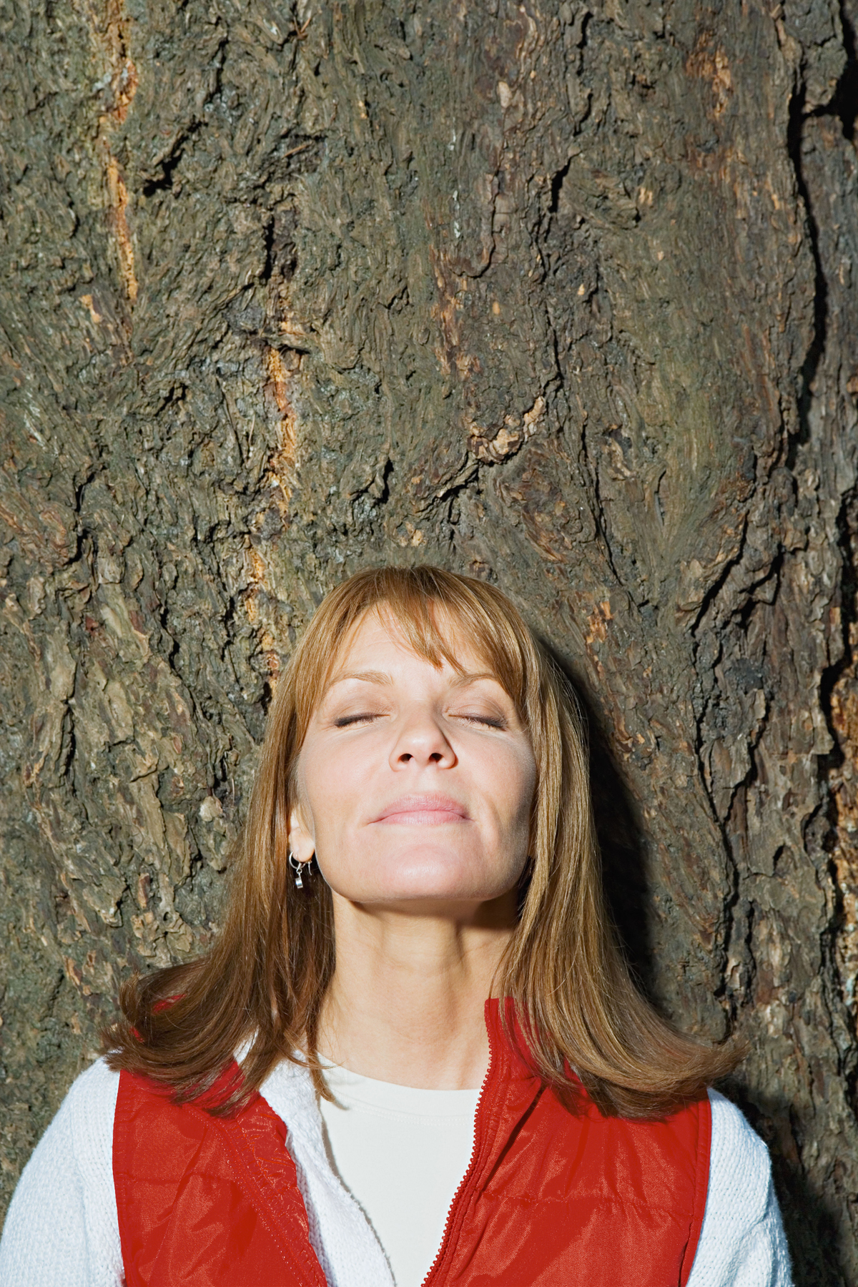
Deep Sleep
Dull state with very little awareness
Body is resting and rejuvenating
Strong bonds may influence (a mother may sense her baby’s needs and wake)
Safety may also influence (someone asleep may wake when hearing the building is on fire)

Slide 6
Dreaming
More awareness than deep sleep with images and memories
Creation of an internal world that seems real
There is a subject/object split; you (the subject) and the environment (the object of your perception)
Upon waking, we consider the dream to be a fabrication

Slide 7

Waking
The state which we experience as our physical reality – the “real” world
Appears solid and structured to our senses with established rules and boundaries
Our localized experiences, where we translate the quantum soup into space-time events
The most vivid and “real” state for many

Slide 8

Atma Darshan
Also known as ‘glimpsing the soul’ or slipping into the gap
This is the non-local reality beyond space-time
Here we find the thinker of thoughts, the essential you, which was never born and can never die
We are not aware of this reality until after returning from it
With practice, aspects of the non-local reality become established in the local

Slide 9
Cosmic Consciousness
Local and non-local reality are experienced at the same time, often referred to as ‘witnessing’
The simultaneous experience of acting in the material world while watching yourself as you perform those actions - during waking, dreaming and sleeping
While you play many roles (mother, father, etc) in the local domain, you know that the real you is not your roles – you experience yourself as the silent witness of the roles you play
Enjoyment of the roles expands as we are no longer overshadowed by our attachment to the good and bad scenes

Slide 10

Divine Consciousness
As we progress in meditation, our awareness of the non-local domain becomes more refined
Recognizing our own true nature, we gradually become aware that the same witness is in everything around us
A deep sense of connectedness to everyone and everything begins to arise

Slide 11
Unified Consciousness
Finally, we realize that not only are we deeply connected to all that is at the level of non-local awareness (or spirit) – but that non-local awareness is undivided and we are all one
We awaken fully to our true self as undefined spirit and the source of all creation; we have the experience of being one with everything
Ahum Brahmasmi – I am the Universe

Slide 12
The Layers of our Existence
Going back and forth between local and non-local awareness during Primordial Sound Meditation enables us to explore all the layers of our existence
These higher states of consciousness unfold naturally and spontaneously
It’s important that we don’t waste time wondering what state of consciousness we are in. Enjoy the benefits – the rest are just labels

Slide 13
