Slide 1
Your Name

Slide 2
Primordial Sound Meditation

Slide 3
Primordial Sound Meditation Program
Taking your next step toward a lifetime of fulfillment
Session One: Introduction to Primordial Sound Meditation
Session Two: Receiving Your Mantra
Session Three: Perfecting Your Practice of Meditation
Session Four: An Exploration of Higher States of Consciousness

Slide 4
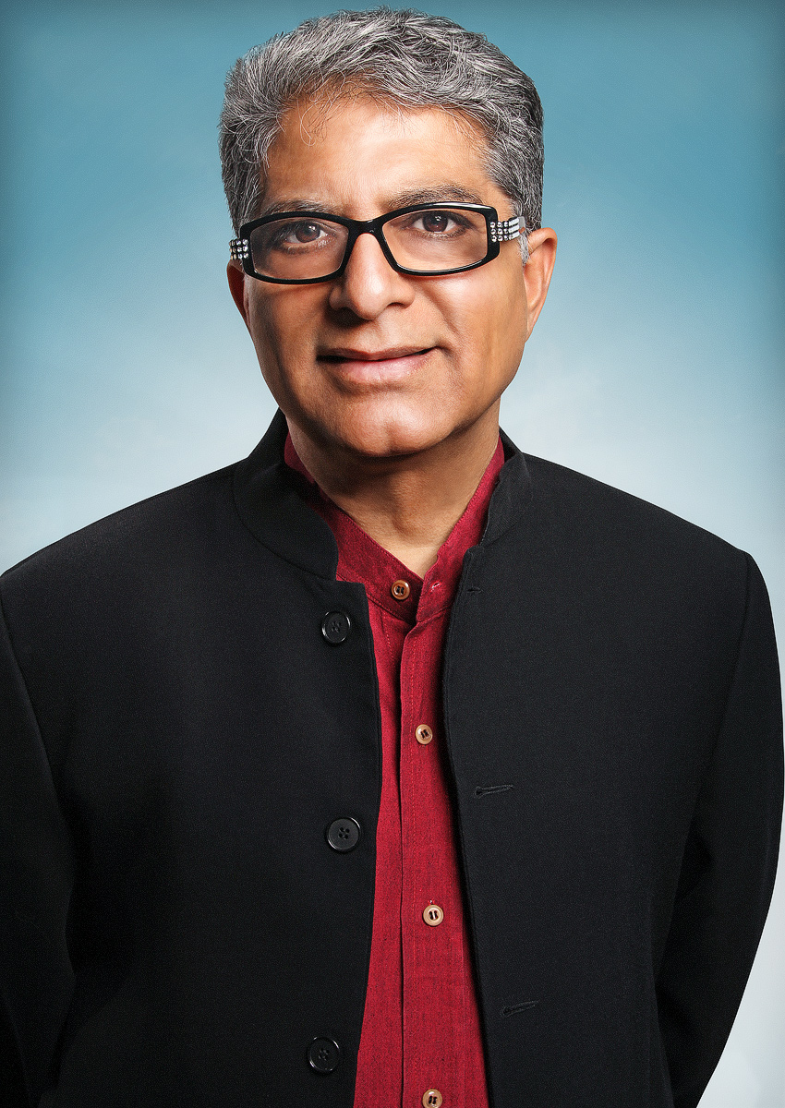
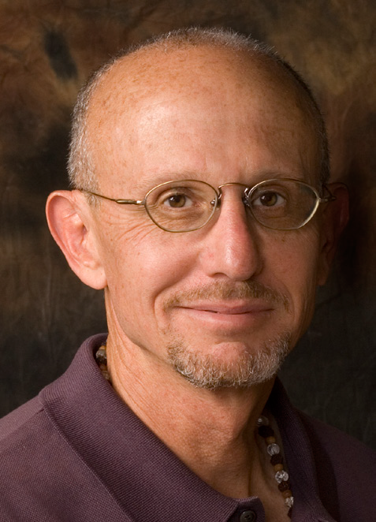
Origins of
Primordial Sound Meditation
Chopra Center established in 1996 in San Diego is the global source of balance, healing, transformation, and expansion of awareness
Primordial Sound Meditation (PSM) is an ancient technique revived by Dr. Chopra and Dr. Simon in conjunction with scholars in the US and India
Over 100,000 people have been taught and 1,300 teachers have been trained in PSM
Deepak Chopra, M.D.
David Simon, M.D.

Slide 5
Antidote to Stress
Stress results from perceiving obstacles to the fulfillment of our needs and desires
What stresses are you experiencing?
Body responds aggressively to these perceived obstacles or threats – the “fight/flight” response

Slide 6
Fight/Flight
Heart beats faster/pumps blood more quickly
Blood pressure rises
Consume more oxygen and expel more carbon dioxide
Perspiration increases
Adrenal glands pumps out adrenaline, noradrenaline, and cortisol

Slide 7
Fight/Flight
Pancreas releases more glucagon and less insulin, raising blood sugar
Shunt blood from your digestive organs to your muscles
Release less rejuvenating hormones (DHEA, growth hormone)
Immune system becomes suppressed
Platelets become stickier

Slide 8
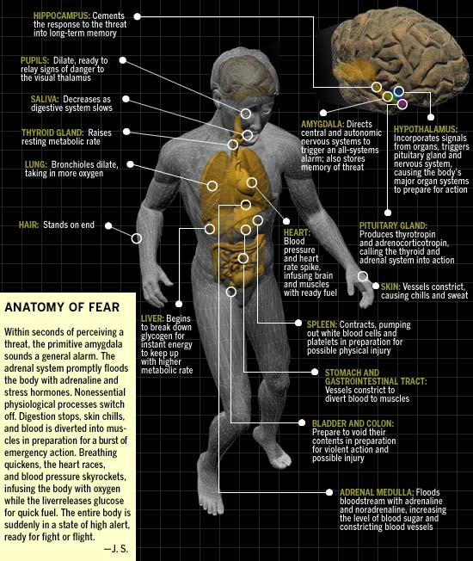

Slide 9
Seeds of Illness
Regular activation of flight/fight response in non-life threatening situations can weaken our health
Change in Physiology | Leads to
Increase blood pressure, heart stress | Coronary heart disease
Increase stress hormones | Anxiety, insomnia, addictions
Increase blood sugar | Diabetes, obesity
Decrease circulation to digestive tract | Digestive disturbances
Decrease growth, sex hormones | Premature aging
Decrease immunity | Infections, cancer
Increase in sticky platelets | Heart attacks, strokes

Slide 10
Restful Awareness
During meditation, the body shifts into a state of restful awareness which counterbalances the fight/flight response
Heart rate slows/pumps blood more slowly
Blood pressure normalizes
Consume less oxygen and expel less carbon dioxide
Perspire less
Adrenal glands produce less adrenaline and cortisol

Slide 11
Restful Awareness
Produce more rejuvenating hormones (DHEA, growth hormone)
Immune function improves
Breathing slows
Platelet function normalizes

Slide 12
War vs. Peace
Fight/Flight
 Heart rate
 Blood pressure
 Respiration
 Perspiration
 Stress hormones
 Anti-aging hormones
 Platelet stickiness
Restful Awareness
 Heart rate
 Blood pressure
 Respiration
 Perspiration
 Stress hormones
 Anti-aging hormones
 Platelet stickiness

Slide 13
Software of the Soul
Karma
(action)
Sanskara (memory)
Vasanas
(desire)

Slide 14
Meditation and Conscious Choice Making
The choices we make are made based on past actions (karma), which create unique memories (sanskara) and desires (vasanas), which prompt future action.

Slide 15
Basics of Meditation
Primordial Sound Meditation takes you beyond mind, intellect and ego
Between each thought there is a gap
This gap is silent and the field of infinite possibilities
You are not your thoughts – your true self is in the gap

Slide 16
Life is multi-dimensional
According to Adi Shankara, 9th century yogic sage, there are 3 primary layers of life: physical, psychological and spiritual.
Although we tend to think of these levels of existence as separate, they are consciousness in different disguises.
When we are able to freely access these different layers, we achieve balance and integration.
Primordial Sound Meditation traverses the full range of experience, from the manifest to the unmanifest.

Slide 17
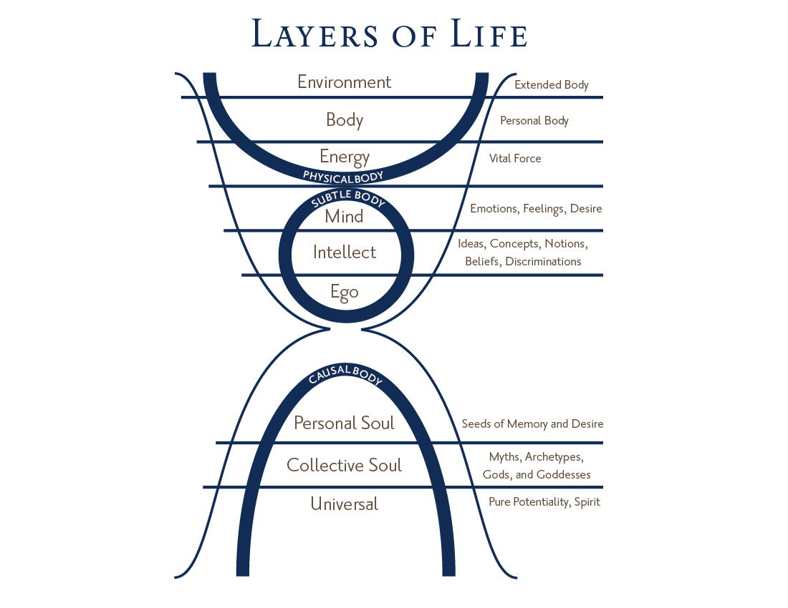
Layers of Life

Slide 18
Primordial Sounds
Everything in creation is made of vibration
Primordial sounds are the vibration of the universe
Cognized by ancient sages and recorded in relation to the position of the moon
Your primordial sound mantra has the effect of drawing your awareness back to the gap

Slide 19
Next Sessions
Receiving Your Mantra
Perfecting Your Practice of Meditation
An Exploration of Higher States of Consciousness

