Slide 1
Your Name
Instructor Title

Slide 2
Perfect Health: Ayurvedic Lifestyle
Inner Pharmacy

Slide 3
Five Gateways
Ears, skin, eyes, tongue and nose are the gateways through which we experience the world
The quality of these sensory impressions determine our thoughts and feelings
Favor experiences that lead to balance and promote well-being
To balance the mind, focus on the sense of smell, sight, and sound
To balance the body, focus on taste and touch
The doshas are tuned into nature. Vata is connected with sound and touch. Pitta with sight. Kapha taste and smell.

Slide 4
Balancing Through Sound
Sound can create harmony within our mind, body, emotions, and spirit
Sounds of Nature: vibrational qualities
Mantras: have specific meanings and purpose
Music: invigorating, calming, and soothing
Chakra Sounds: chakra toning/awakening practices
Speech: conscious communication

Slide 5
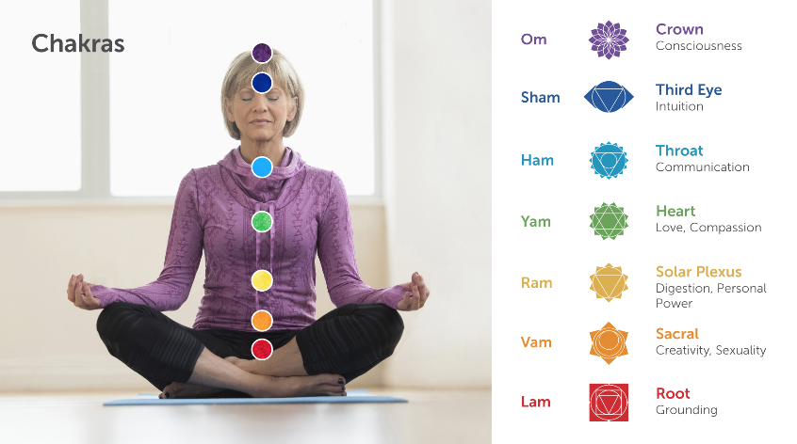
Chakras Energy centers that have a location within the body, a color, a sound and specific emotional/physical functions
xx

Slide 6
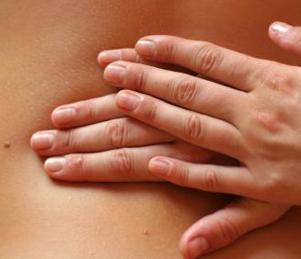
Balancing Through Touch
Regular massage and loving touch detoxify the body’s tissues
Daily self massage (self abhyanga) is an important aspect of daily routine:
Calms the mind
Improves circulation
Enhances immune function

Slide 7
Balancing Through Touch
Nourish your body with oils to balance your dosha
Vata: Favor heavier, warming oils such as sesame or almond oil
Pitta: Favor cooling, soothing oils such as coconut, sunflower or olive oil
Kapha: Favor light, warming oils such as sunflower, safflower, or mustard oil

Slide 8
Balancing Through Sight
The images we ingest have a profound effect on our physiology, including our mind and emotions
Images and patterns can increase or decrease balance and harmony
Balancing colors for each dosha

Slide 9
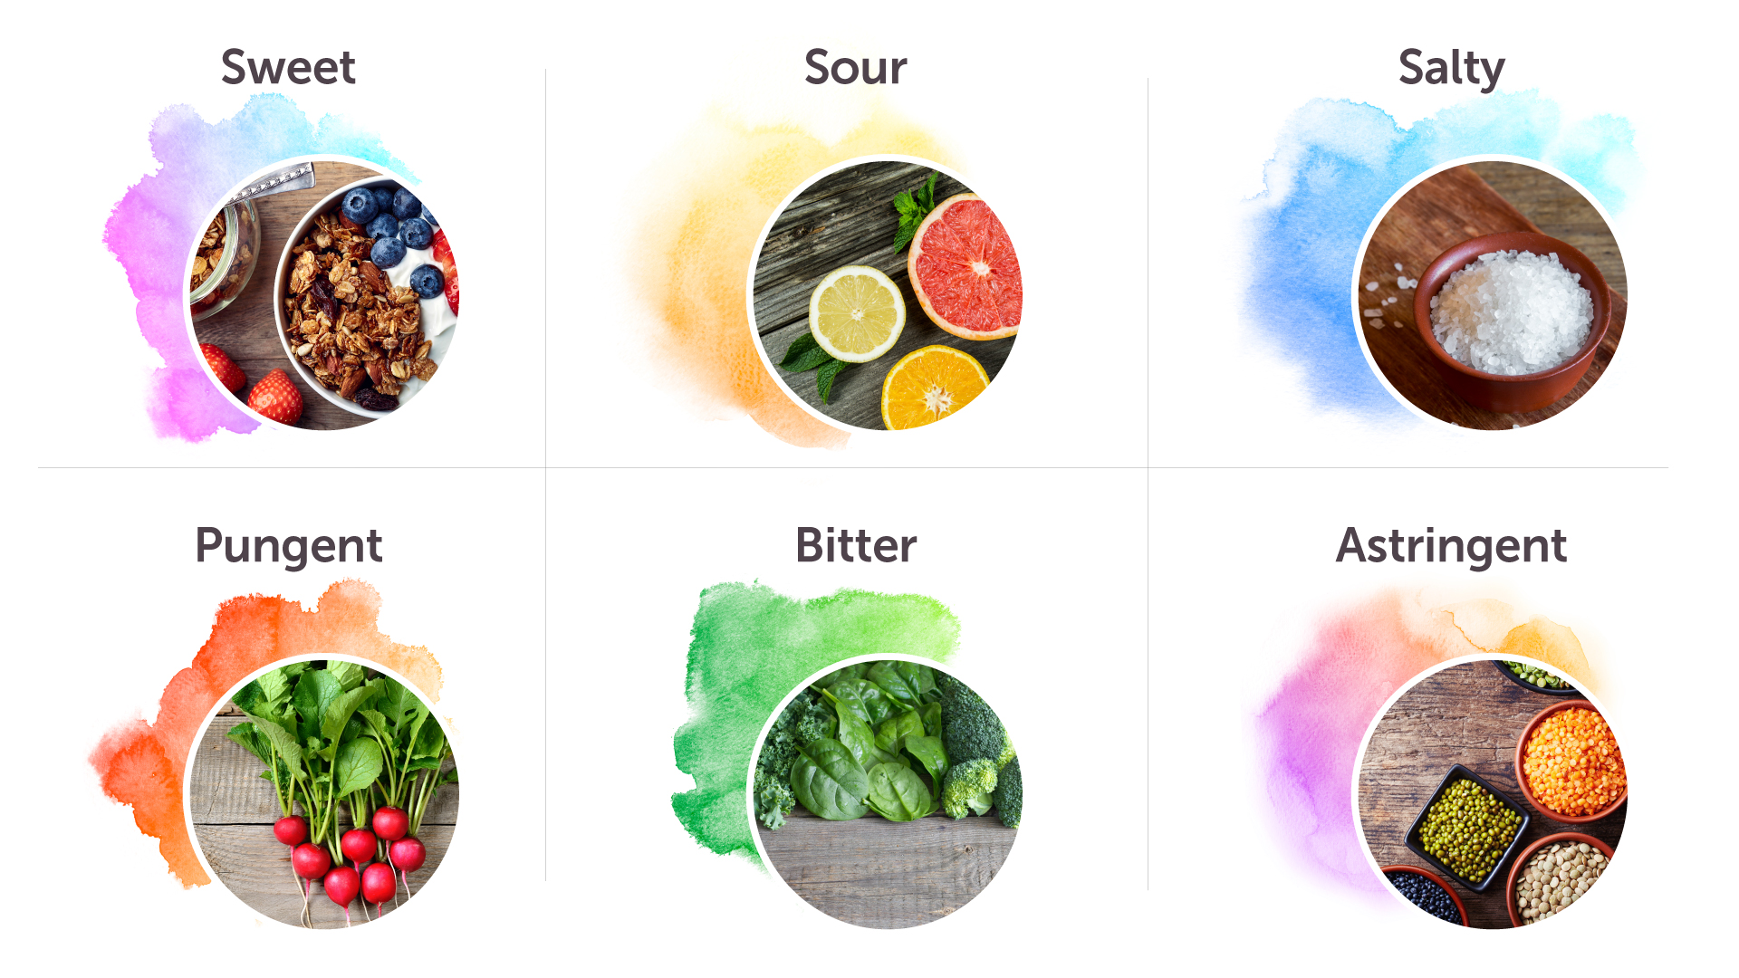
Balancing Through Taste
Eat the six tastes and foods to balance the doshas
Enjoy the colors of the rainbow, and wide variety of fresh, organic foods that support your agni
Mindful eating practices

Slide 10
Balancing Through Smell
Aromas connect us to emotions, memory and instincts
We can link a healing response to the experience of a particular smell

Slide 11
Balancing Through Smell
Use specific aromas for each dosha
Vata: Favor floral, fruity, warm, sweet and sour, such as basil, orange, geranium, clove, vanilla, patchouli
Pitta: Favor cooling and sweet, such as sandalwood, mint, rose, jasmine, lavender
Kapha: favor stimulating, spicy and aromatic, such as eucalyptus, camphor, juniper, clove, marjoram

Slide 12
Healing Through Laughter
Belly laughter enhances immune function
Laugh and enjoy the experiences of life
How can you bring more laughter and joy into your life?

Slide 13
Enlivening Health
Bring awareness of everything you take in from your senses. Practice techniques to balance and harmonize each of the senses
Perform a daily massage
Use aromatherapy to create an association between pleasing fragrances and relaxation

