Slide 1
Your Name
Instructor Title

Slide 2
Perfect Health: Ayurvedic Lifestyle
Emotional Freedom

Slide 3
Ayurveda and Emotional Well-being
Ayurveda recognizes that emotional balance is one of the fundamental pillars of health
In Ayurveda, health is not merely the absence of disease – it is a state of physical, emotional, mental, and spiritual well-being
Our bodymind is affected by our emotions and cultivating emotional freedom begins with awareness - awareness of our feelings, what we need, what we need to release, and what brings us joy and happiness

Slide 4
Happiness
We all share a desire to be happy
We are conditioned to derive happiness from temporary, external sources -- when we identify ourselves and our happiness with objects outside ourselves, this is known as object referral
The opposite of object referral is self-referral – we identify with our inner self and internal state of well-being that does not depend on external circumstances
True joy is an internal state of awareness that allows us to be happy for no reason and is independent of circumstances, events, people, and things in our lives. Our essential nature is pure unbounded consciousness with infinite possibilities

Slide 5
Needs
Fundamental Human Needs
When we perceive our physical and psychological needs are met, we feel comfort, pleasure, happiness, contentment, satisfaction and cheerfulness

Slide 6
Emotions
Emotions are derived from our perception of needs being met or not met
Emotions are energy in motion and we feel them as sensations in our body associated with thoughts in our mind
Two core emotions are:
Comfort – encompasses all the feelings that move us from constriction to expansion, including joy, peace, love, pleasure, delight, and gratitude
Discomfort – includes all the feelings that constrict us, including distress, frustration, anger, regret, fear, pain, and sadness
Secondary emotions based on unmet needs, if not resolved, often lead to anxiety, hostility, guilt and depression
Feelings not fully experienced can accumulate as emotional toxins (emotional ama)

Slide 7
Emotions
We can either react to unmet needs, which is an instinctual, conditioned, and learned behavior, or we can respond, which implies being aware and having a choice
All the doshas can experience every kind of emotion, though each dosha has a tendency to react to unmet needs in different ways
Vata – have a tendency to react with feelings of anxiety, fear, worry, and guilt. They are likely to blame themselves and say “what did I do wrong?”
Pitta – have a tendency to feel angry or hostile. They are prone to blame others and say “what did you do wrong?”
Kapha – have a tendency to become sad and discouraged. They may ignore situations and withdraw and say “I don’t want to deal with it.”

Slide 8
Seven Biological Responses
Fight/Flight
Reactive
Restful Awareness
Intuitive
Creative
Visionary
Sacred

Slide 9
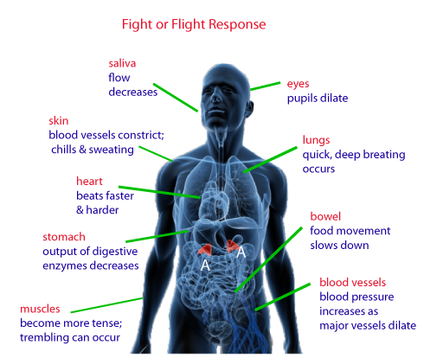
Flight/Fight Response
The most primitive response grounded in the survival instinct, serving to keep the body protected
Based on fear and the perception that our environment is threatening
Acute stress

Slide 10
Reactive/Ego Response
Psychological equivalent of flight/fight
Attempt to control the environment through reactivity
Emotions are in the domain of the ego and when we perceive that boundaries are crossed or needs not met, uncomfortable feelings are generated and we react to them
Most of us only use the flight/fight and reactive responses
We can move from constriction to more expanded states

Slide 11
Flight/Fight/Freeze Responses
Defensive responses to a perceived threat
Defensive Response | Qualities | Corresponding Dosha
Flight | Avoidance Anxiety Fear | Vata
Fight | Irritability Loss of Temper Defensiveness | Pitta
Freeze | Numbing Detachment Giving Up Easily | Kapha

Slide 12
Restful Awareness Response
Body relaxes and you bypass the reactive response
Internal reference shifts from ego to spirit
Witness the activity of the mind and become capable of conscious choice making
Best cultivated through the practice of meditation
 Heart rate
 Blood pressure
 Respiration
 Perspiration
 Stress hormones
 Anti-aging hormones
 Platelet stickiness

Slide 13
Intuitive Response
Being aware of our interpretations
Choosing conscious observation and authentic expression
Present moment awareness in our daily lives
Facilitates conscious communication
Restful awareness (meditation) plays a key role

Slide 14
Creative Response
Applying a new context or meaning to a situation or circumstance
Solutions emerge by quieting down inner dialogue
7 Steps for Awakening the Creative Response
Intention
Information Gathering and Analysis
Incubation
Insight
Inspiration
Implementation
Integration/Incarnation

Slide 15
Visionary Response
Living from the collective soul
Vision of what is possible
Ability to access collective dreams and the archetypal realm
Consciously participate in the story of our lives
Questions for Awakening the Visionary Response
What stories would you like to enact?
Who inspires you?
What attributes do you connect with?

Slide 16
Sacred Response
Sense of self expands beyond constricted ego
Unity consciousness
Compassion is a natural expression
Transcend “what’s in it for me” and dwell in “how can I be of service?”
As a wave is to the ocean, each of us is to Spirit

Slide 17
Conscious Communication
Use this process to gain clarity about how you feel, identify what you need, and take responsibility to consciously communicate your needs to another person:
What happened? State the facts
What am I feeling? Describe how you feel, choosing words that describe only the emotion and avoid victimization words
What do I need that I’m not receiving? Identify the need you have that isn’t being met
What am I asking for? Make your request with a level of respect, rather than a demand
What is the gift or opportunity in this situation? Observe what you benefited from the practice of this process
Based on the work of Marshall Rosenberg (Nonviolent Communication)

Slide 18
Words List
When our needs are being met
When our needs are NOT being met
Avoid words that encourage victimization
Bright Carefree Delightful Enthusiastic Glowing Hopeful Invigorated Joyful Loving | Optimistic Peaceful Quiet Radiant Secure Thankful Upbeat Vivacious Warm
Afraid Anxious Bitter Confused Embarrassed Frightened Frustrated Guilty Helpless | Irritable Invisible Jealous Lonely Overwhelmed Pessimistic Resentful Unhappy Withdrawn
Abandoned Betrayed Cheated Diminished Manipulated Neglected Pressured Unappreciated Unwanted
Based on the work of Marshall Rosenberg (Nonviolent Communication)

Slide 19
Seven Steps to Emotional Clearing
Take responsibility for what you are feeling
Identify the emotion
Witness the feeling in your body
Express the emotion in private to yourself
Release the emotion through a ritual
Share the emotion with a good listener
Rejuvenate with a celebration!

Slide 20
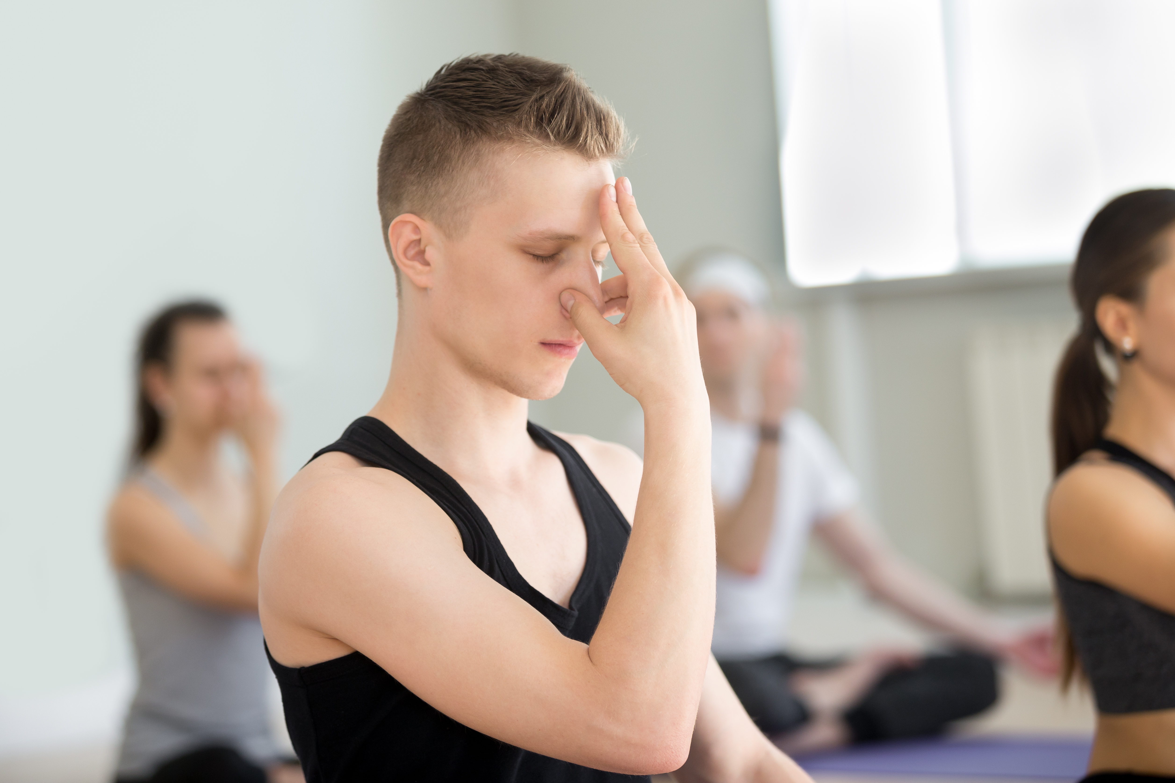
Pranayama for Emotional Release
Pranayama practices activates the body’s parasympathetic nervous system, which governs the rest-and-digest response, also known as the relaxation response
Slow, rhythmic belly breathing
Complete Breath
Nadi Shodhana
Ujjayi
Bhastrika

Slide 21
Journaling
Develop a vision statement for your life. Describe in detail the sights, sounds, feelings, and experiences you would like to see unfold in your life.
My Needs and Desires:
Physical Body and Health
Spiritual
Family
Career
Friends and Loved Ones
Material Possessions

Slide 22
Enlivening Health
Notice when emotions arise and identify your needs
Review the steps of conscious communication
Practice the seven steps for emotional clearing
Create a regular journaling practice, including a vision statement/intentions

