Slide 1
Your Name
Instructor Title

Slide 2
Perfect Health: Ayurvedic Lifestyle
Ayurvedic Nutrition

Slide 3
Agni – We Are What We Digest
Agni = fire or ignite
The metabolic power responsible for extracting nourishment and eliminating toxins
Our health depends on proper digestion
When our digestive fire is strong and healthy, we can easily digest food and experiences. We extract the greatest level of nourishment from our diet (ojas)
When our digestive fire is weak or irregular, we can not properly digest even potentially nourishing substances and our body starts to accumulate toxins (ama)
We keep agni strong by eating the proper amount, eating the right foods, and by managing stress which can dampen agni

Slide 4
Agni – Maintain Health and Prevent Disease

Slide 5
Ojas and Ama
Ojas - Vital Nectar of Life
Feel rested upon awakening
Skin has a healthy glow
Tongue is pink and clear
Body feels light, regardless of your weight
Feel centered throughout the day
Digestion is strong without bloating
Feel energized & enthusiastic
Mind is clear
Body has a pleasant smell
Rarely get sick
Ama - Toxic Residue
Bad breath
Coated tongue
Dull appetite
Delicate digestion
Generalized pain
Fatigue
Depression
Susceptibility to infections
Sluggish or irritable elimination
Difficulty manifesting intentions

Slide 6
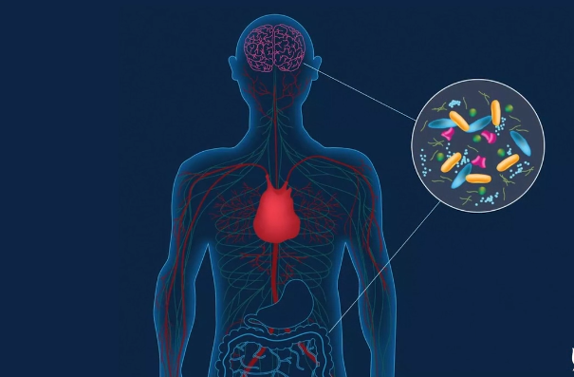
Microbiome – Important for Digestion
The microbiome is a vast colony of micro-organisms that inhabit our body, including bacteria and other microbes
These microbes live mainly in our digestive tract, but also on our skin, in our mouth, and in other locations
Most are beneficial for our health. Microbiome help to digest our food, regulate hormones and immune system, and influence our nervous system and emotions
In your daily life, the choices we make about what we eat can make the greatest difference in cultivating a healthy gut microbiome
Avoid refined and processed foods and favor fresh, real food, you can be assured that you are nurturing your microbiome and bodymind with the highest quality, anti-inflammatory nutrition

Slide 7
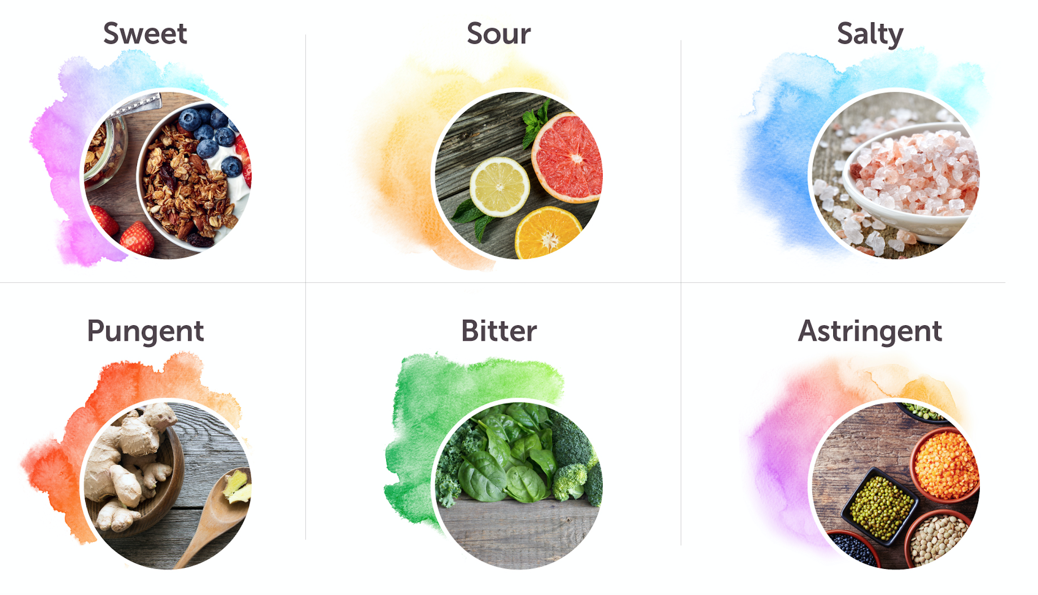
The Six Tastes of Life

Slide 8
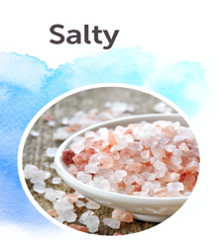
The Six Tastes of Life
Proteins, carbohydrates, and fats
Most nutritive, builds tissue
Grains, dairy, starchy vegetables, fruits, bread, pasta, nuts, seeds, oils, sweeteners, eggs, animal products
Primary elements: Earth and Water
Organic acids
Promotes appetite and digestion
Citrus fruits, berries, tomatoes, yogurt, cheese, fermented foods, pickles, vinegar, alcohol
Primary elements: Earth and Fire
Mineral salts
Promotes digestion
Salt, sea vegetables, fish, shellfish, animal products, soy sauce, condiments
Primary elements: Fire and Water

Slide 9
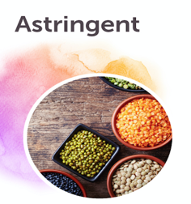
The Six Tastes of Life
Essential oils
Stimulates digestion and detoxification
Peppers, ginger, radishes, onions, garlic, turmeric, cinnamon, cloves, basil
Primary elements: Fire and Air
Alkaloids, glycosides
Anti-inflammatory and detoxifying
Green and yellow vegetables, green leafy vegetables, rosemary
Primary elements: Air and Space
Tannins, fiber
Healing, compacting
Beans, legumes, vegetables, apples, pomegranates, nuts, non-herbal teas
Primary elements: Earth and Air

Slide 10
Foods for the Doshas
Vata
Favor: Sweet, Sour, Salty
Reduce: Pungent, Bitter, Astringent
Include warm, oily, heavy and grounding foods to reduce dryness, digestive imbalances, emaciation
Decrease gas and bloating by cooking with aromatic herbs (cinnamon, cardamom, bay) and chew roasted fennel seeds after meals

Slide 11
Foods for the Doshas
Pitta
Favor: Sweet, Bitter, Astringent
Reduce: Pungent, Sour, Salty
Include cool foods and liquids to reduce inflammation, heartburn, irritability, rashes
Alleviate excess acidity by cooking with cooling herbs (cumin, coriander, fennel, cilantro)

Slide 12
Foods for the Doshas
Kapha
Favor: Pungent, Bitter, Astringent
Reduce: Sweet, Sour, Salty
Include, light, dry, warm foods to reduce weight, congestion, allergies, fluid retention, sluggishness
Kindle the digestion with some freshly sliced ginger before meals

Slide 13
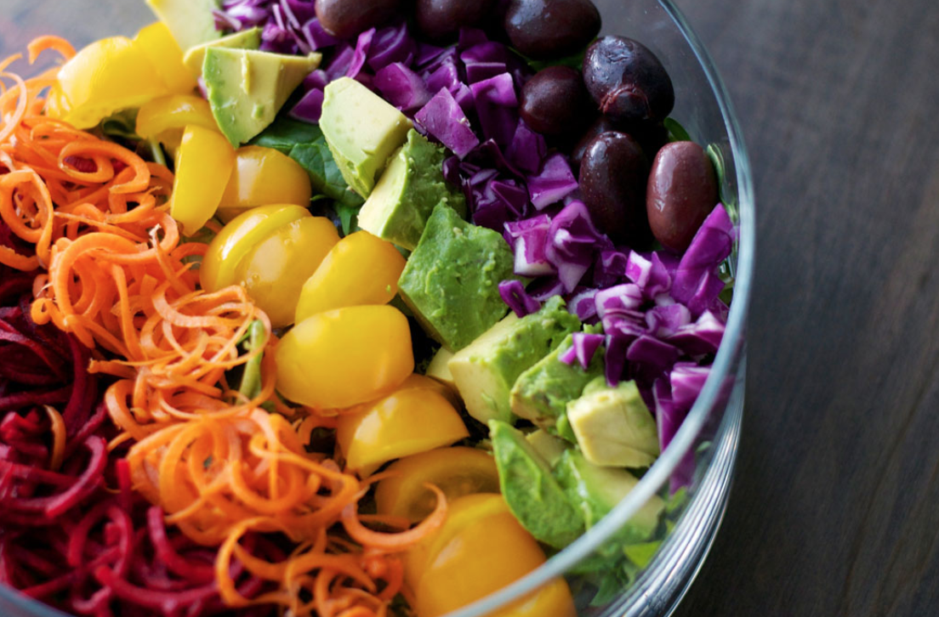
Colors, Phytonutrients and Superfoods
Eat the Rainbow
Eat a variety of colorful foods to receive a broad spectrum of nutrients
Deep pigments in plant foods are dense with nutrients and generally have more antioxidants
Cook with color to add visual appeal and encourage appreciation of a meal
Boost Immunity & Enhance Health
Phytochemicals are non-nutritive plant chemicals that have protective or disease preventive properties
Benefits include protection against oxidative damage, decreased risk of cancer and heart disease
The easiest way to get more phytochemicals is to eat more fruit and vegetables

Slide 14
Mindful Eating Techniques
Pay attention to hunger cues before you begin eating
Eat freshly prepared meals, engage all five senses and take your time
Eat your biggest meal in the middle of the day when agni is strongest
Eat in a comfortable environment and be present with your food
Focus your attention on the sensations of eating
Sit down to eat and enjoy your food
Avoid overeating, leave room for digestion
Reduce ice-cold foods and beverages
Sit quietly for a few minutes after your meal while focusing attention on body, then take a short walk

Slide 15
Enlivening Health
Keep your agni strong
Include all the six tastes and seven colors at every meal
Eat mindfully and tune into your body. Notice which mindful eating tips are spontaneous and which require more attention
Eat one meal in silence this week and record how you felt while eating

