Slide 1
Your Name
Instructor Title

Slide 2
Perfect Health: Ayurvedic Lifestyle
Introduction to Ayurveda

Slide 3
The Perfect Health: Ayurvedic Lifestyle Program
Tools to enhance your physical and emotional well being
Lesson 1 – Introduction to Ayurveda
Lesson 2 – Ayurvedic Nutrition
Lesson 3 – Emotional Freedom
Lesson 4 – Inner Pharmacy
Lesson 5 – Ayurvedic Daily Routines

Slide 4
Ayurveda
The Science of Life
Ayurveda: Ayus = life, Veda = science or knowledge
5,000 year-old consciousness based system of healing from India
The purpose of Ayurveda is to help us return to our natural state of health, balance, and wholeness
Ayurveda recognizes the primacy of consciousness and offers powerful practices that can help us change the qualities of our experiences in consciousness to create health and balance in your mind-body system
Our essential and ground state is pure consciousness, pure potentiality, and the field of all possibilities. Consciousness is the source of all our experiences, including our sensations, images, feelings, thoughts, imagination, creativity, perceptions, insight, and intuition

Slide 5
Ayurveda
The Science of Life
Ayurvedic practices include sensory modulation, meditation, yoga, nutrition, emotional wellbeing, physical activity, breathing practices, daily routines and many other tools and practices for shifting our consciousness towards health and happiness
Ayurveda is experiential and there is no “one size fits all” prescription for well-being: instead, every health-related measure is based on an individual’s mind-body type, or dosha, and the needs that derive from it
The six most important pillars of health to focus on in our daily lifestyle are sleep, meditation, movement/physical activity, healthy emotions, grounding, and optimal nutrition. All of these components are included in the Perfect Health Program.

Slide 6
The Benefits of Ayurveda
Current scientific research validates Ayurvedic practices
Ayurvedic practices can change gene expression to promote wellness, self-regulation, and homeostasis (balance)
Three studies conducted at the Chopra Center’s Perfect Health program and the Seduction of Spirit programs reported:
Anxiety reduction
Sustained increases in psychological well-being
Decrease in chemicals that may increase the risk of heart disease

Slide 7
Body, Mind and Soul
We are inseparable parts of the infinite field of intelligence
The physical world, including our body, is a reflection of our perceptions, thoughts, and feelings
Our body is dynamic and constantly transforming. We are not static physical machines that have learned manufactured thoughts, emotions, and ideas. Rather, we are a network of intelligence in dynamic exchange with everything that surrounds us

Slide 8
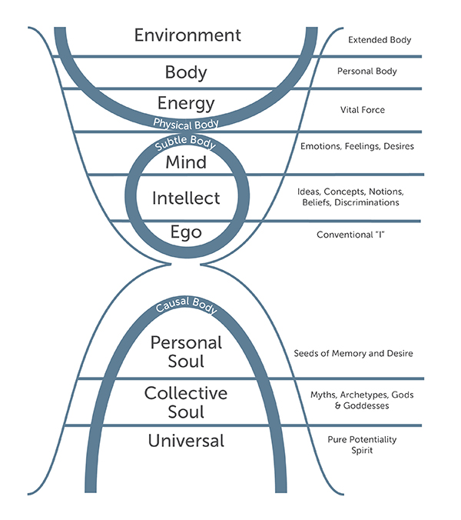
Layers of Life
There are three primary layers of life: physical, mental, and spiritual
These layers of existence are not separate, they are consciousness in different disguises
Primordial Sound Meditation enables us to witness these layers from a new perspective
Balance and healing can occur when we are able to freely access these different layers

Slide 9
Five Elements Building blocks of nature that make up everything we perceive through our senses
These exist both within us and in the world around us
Space (AKASHA) – Potential
Air (VAYU) – Change
Fire (TEJAS) – Transformation
Water (JALA) – Cohesiveness
Earth (PRITHIVI) – Form/Protection

Slide 10
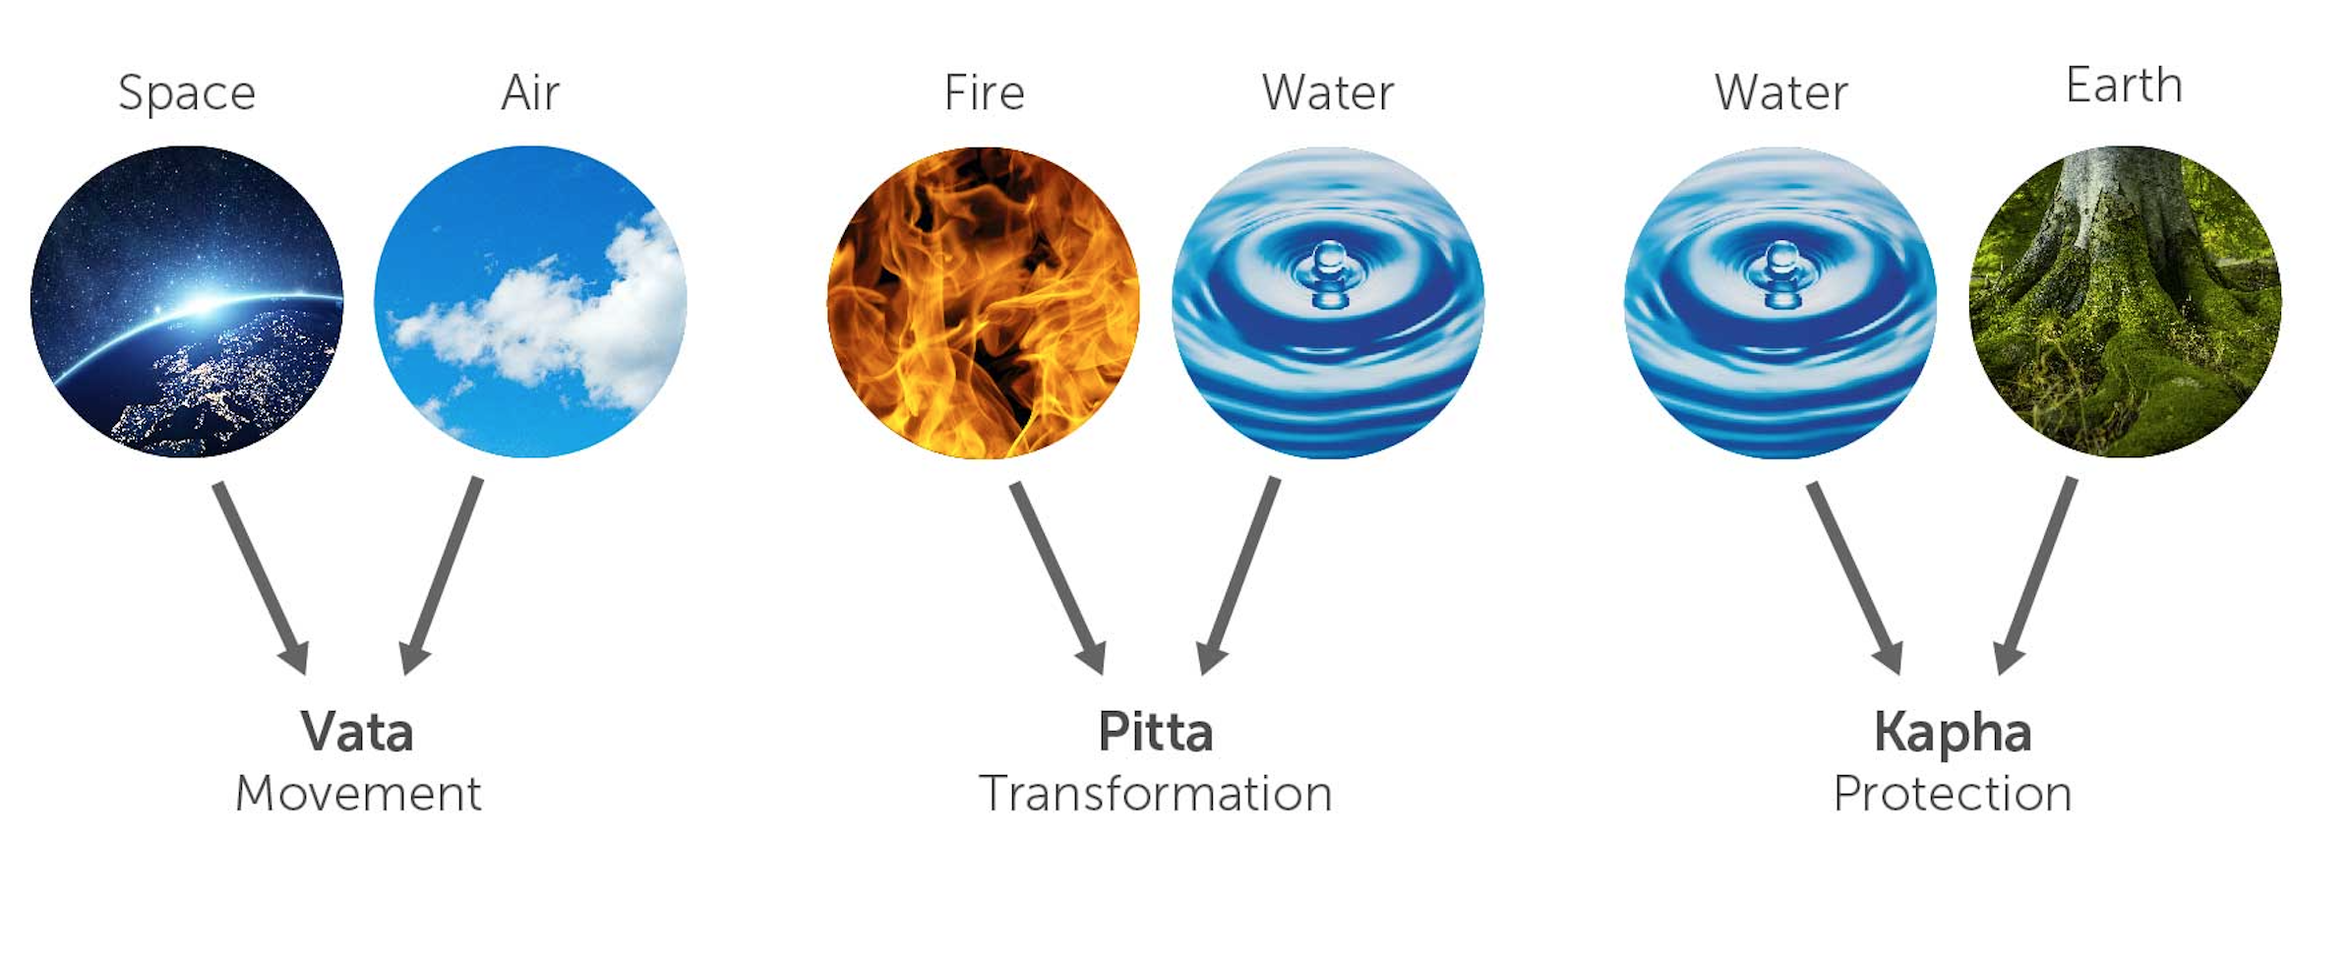
Three Doshas Mind Body Constitutions

Slide 11
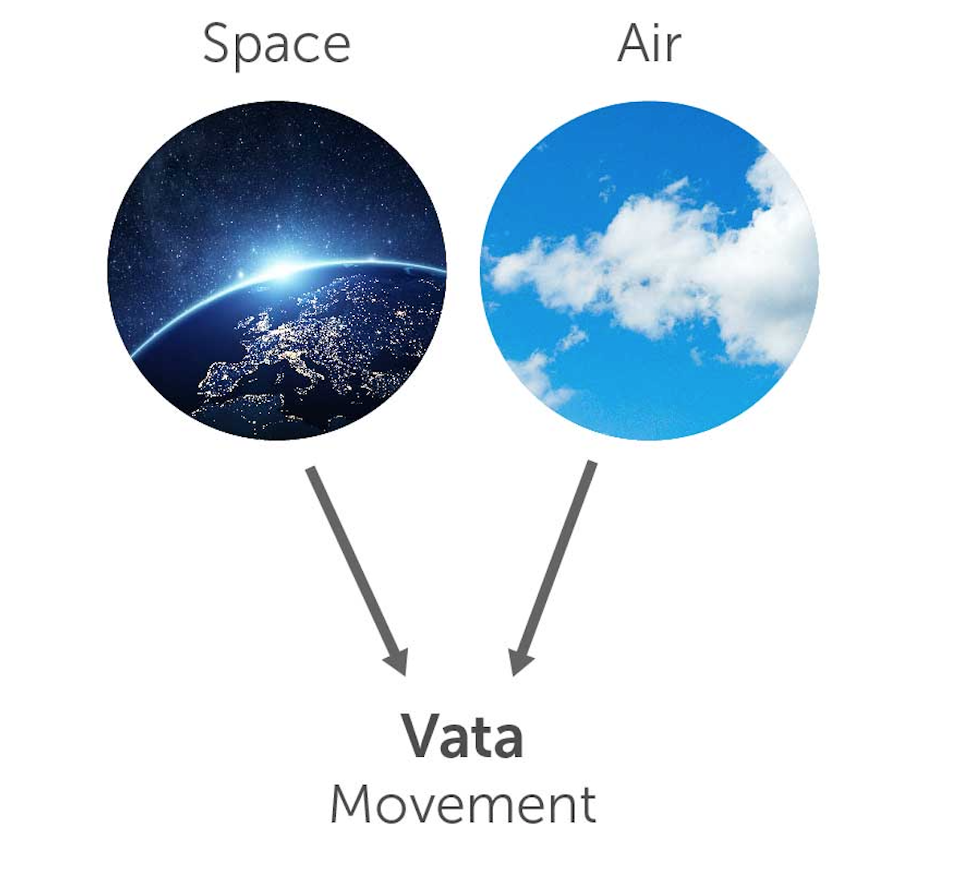
Vata Primary Functions: Movement, Transportation
Qualities of Vata
Cold
Light
Dry
Sharp
Irregular
Rough
Mobile
Quick
Changeable

Slide 12
Vata Resembling the Wind
Characteristics
Thin, light frame
Variable digestion and sleep patterns
Dry skin and hair
Cold hands and feet
Moves and talks quickly
Quick and imaginative
Resists routine
Welcomes new experiences
Balanced
Energetic
Creative
Adaptable
Shows initiative
Good communicator
Spontaneous
Enthusiastic
Lively
Imbalanced
Overactive Mind
Anxiety
Worry
Inconsistency
Insomnia
Constipation
Gas, bloating
Fatigue

Slide 13
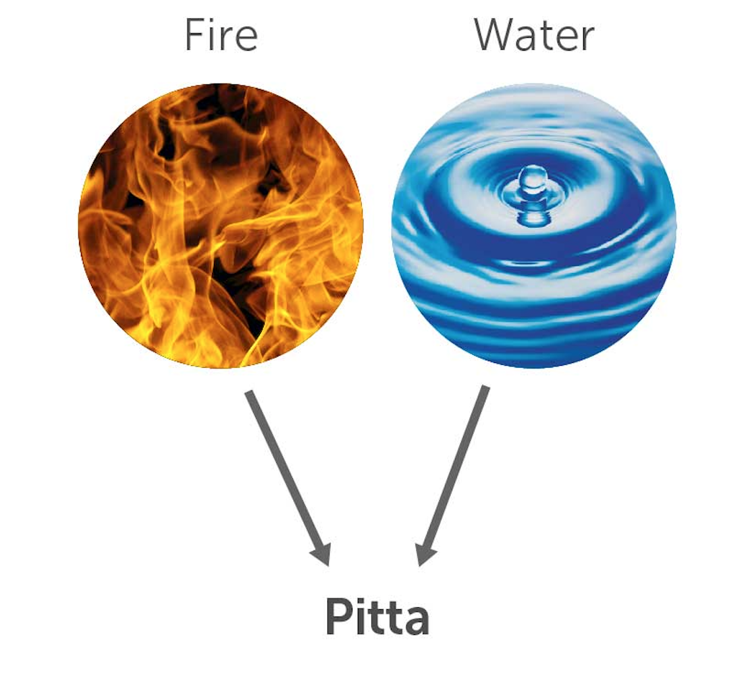
Pitta Primary Functions: Transformation, Metabolism
Qualities of Pitta
Hot
Light
Intense
Penetrating
Pungent
Sharp
Acidic
Moist

Slide 14
Pitta Fiery In Nature
Characteristics
Medium build
Strong appetite
Warm body temp
Sleeps soundly for short periods
Sharp intellect
Direct and precise
Organized routine
Ambitious
Courageous
Balanced
Bright
Warm
Friendly
Focused
Intelligent
Decisive
Natural leader
Strong digestion
Passionate
Imbalanced
Angry
Irritable
Excessively critical
Judgmental
Aggressive
Skin rashes
Inflammation
Indigestion

Slide 15
Kapha Primary Functions: Protection, Structural Integrity
Qualities of Kapha
Cold
Heavy
Solid
Stable
Smooth
Oily
Slow
Steady
Soft

Slide 16
Kapha Grounded, Unruffled, May Resist Change
Characteristics
Heavyset
Smooth skin and thick hair
Deep sound sleep
Slow moving
Good stamina
Easygoing
Methodical, thoughtful nature
Detail oriented
Enjoys routine
Balanced
Steady
Consistent
Loyal
Strong
Grounded
Supportive
Loving
Content
Calm
Patient
Imbalanced
Dull
Inert
Needy
Attached
Congested
Overweight
Complacent
Lethargic
Overly-protective
Resistant to healthy change

Slide 17
Individual Mind-Body Constitution
Prakruti
Individual constitution - determined at conception
All three doshas are present in everyone, but one or two typically predominate
Vikruti
Current state of balance - now!
Reflects imbalances that are influenced by experiences and choices
Maintaining balance is essential to health

Slide 18
Referring to Mind-Body Constitutions
Vata
Pitta
Kapha
Vata-Pitta or Pitta-Vata
Pitta-Kapha or Kapha-Pitta
Kapha-Vata or Vata-Kapha
Vata-Pitta-Kapha or Tri-Doshic

Slide 19
Mind Body Questionnaire Interpreting Your Results
Section One
Gathers information about your basic nature
Provides proportions of Vata, Pitta and Kapha at conception
Primary doshas and basic nature doesn’t change, but may express themselves differently depending on stage of life or season
Section Two
Snapshot of current mind-body state
Follow recommendations corresponding to the highest body and highest mind score to restore balance
Sense of sight, sound, and smell to balance the mind. Sense of taste and touch to balance the body.

Slide 20
Enlivening Health
Begin thinking of yourself as a multidimensional being. Notice how awareness expands or constricts
Become familiar with the dosha qualities and characteristics to bring awareness and notice when imbalances arise. Take steps to restore balance
Remember there is no “one size fits all” prescription for well-being

