Slide 1
Your Name
Instructor Title

Slide 2
Perfect Health: Ayurvedic Lifestyle
Introduction to Pranayama

Slide 3
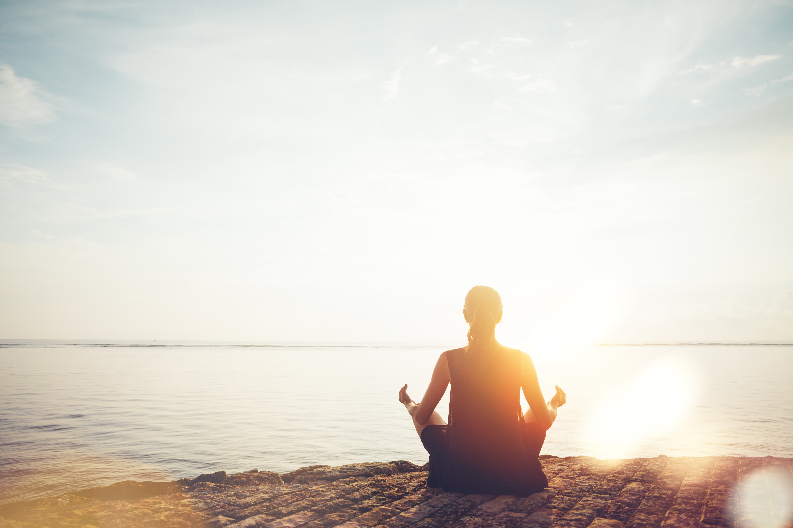
What is Pranayama?
The practice of becoming aware of your breath and using it to enhance your physical, emotional, and spiritual well-being
Pranayama
prana = vital life force
ayama = to expand, draw out, control
Using the breath to expand life-force energy and improve communication among all parts of body-mind

Slide 4
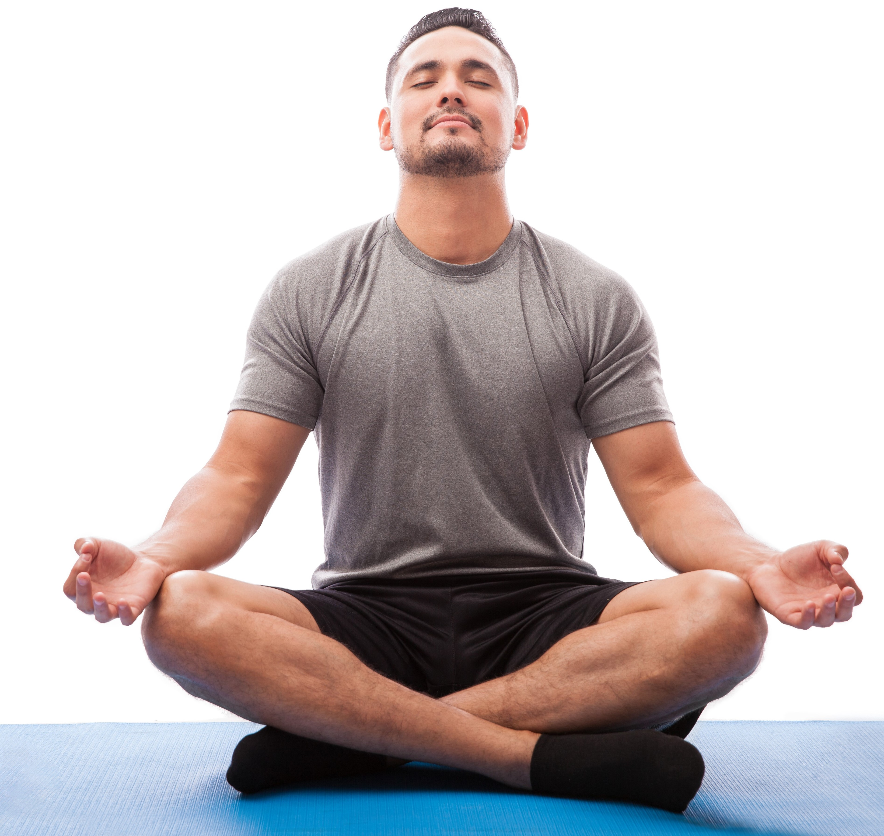
Positively Influences Health
By controlling the breath, we can train ourselves to breathe in a way that positively influences our health
Our thoughts affect our breathing
Our breathing influences our thoughts and physiology
When the mind is calm, breathing is deep and rhythmic, and the body engages in its natural self-repair, self-healing mechanisms

Slide 5
The Benefits of Pranayama
There is a growing body of scientific research documenting the benefits of practicing pranayama on a regular basis, including:
Reduced anxiety and depression
Lower/stabilized blood pressure
Increased energy levels
Muscle relaxation
Decreased feelings of stress and being overwhelmed

Slide 6
Scientific Research
The following studies offer additional information on pranayama’s benefits:
Sudarshan Kriya yogic breathing in the treatment of stress, anxiety, and depression: part 1-neurophysiologic model.” RP Brown, et al.
“Stress Management: Approaches for preventing and reducing stress.” Harvard Medical School.
“Yoga breathing, meditation, and longevity.” RP Brown, et al.
“Breathing-based meditation decreases posttraumatic stress disorder symptoms in US military veterans: a randomized controlled longitudinal study.” EM Seppala, et al.

Slide 7
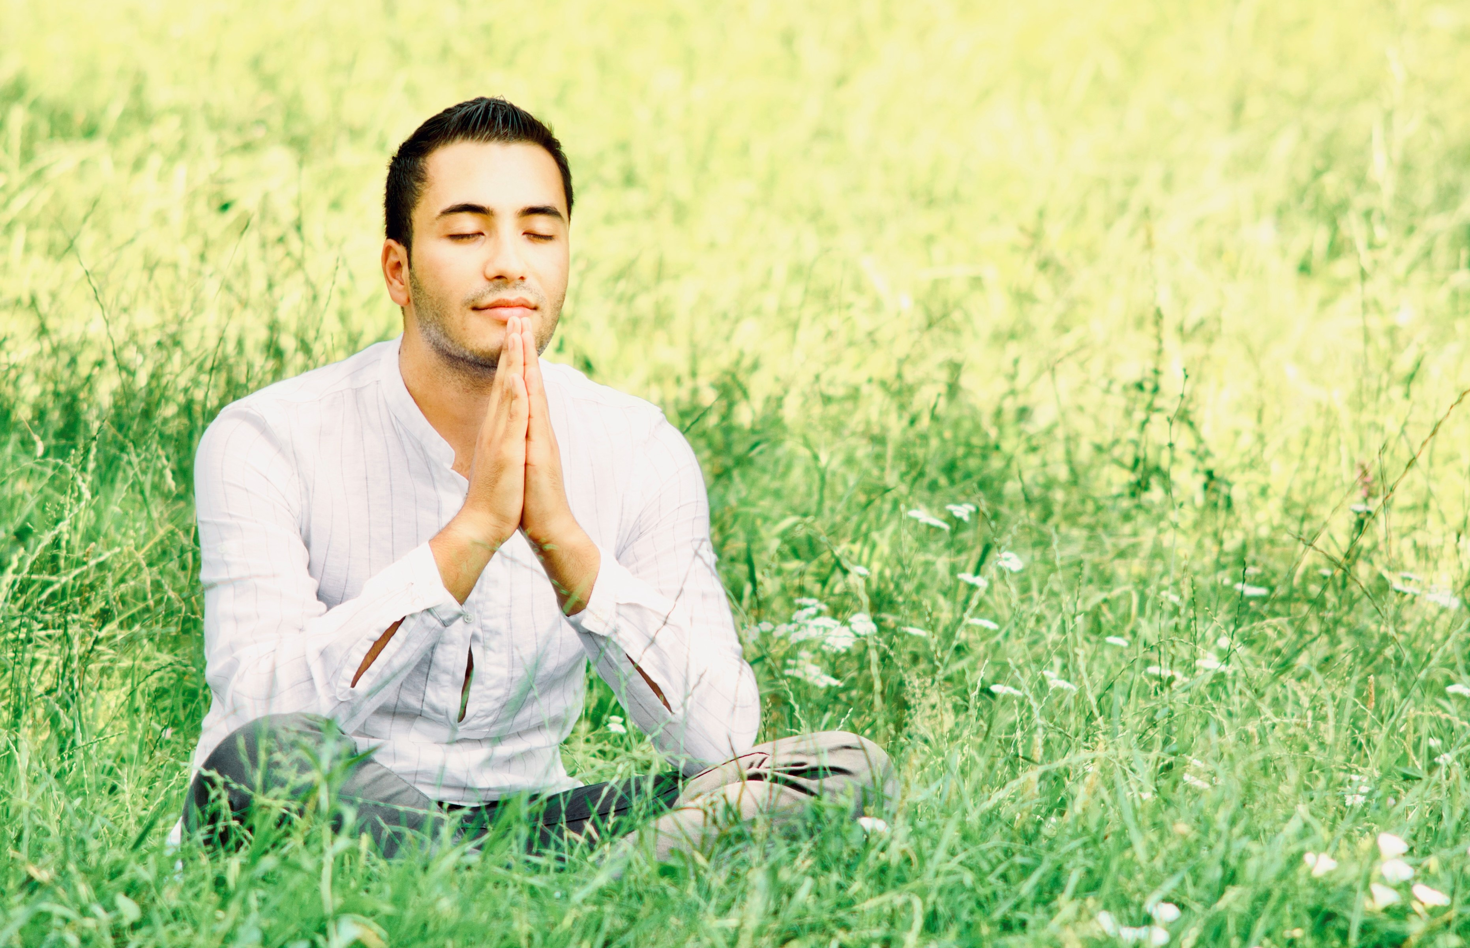
Coherence Breathing
Healing Benefits
Decreases anxiety and depression
Improves sleep
Strengthens immune function
Reduces inflammation
Increases resilience
This practice is recommended for all doshas
To receive the full benefits, practice mindfully, then relax and sit quietly for a few moments before slowly resuming activity

Slide 8
Coherence Breathing
Sit comfortably in a chair or on the floor. The eyes may be opened or closed.
Place the hands on the belly if that feels comfortable. This will allow you to feel the belly move out on the inhale and in on the exhale.
Relax the belly to let the breathing be effortless.
Inhale, letting the belly expand into the hands for a count of four; then exhale, letting the belly gently draw in to a count of five. Repeat this pattern.
Continue in this way for another three or four breaths.

Slide 9
Nadi Shodhana
Relaxing Breath:
nadi (channel of circulation) shodhana (cleansing)
Clears emotional blockages and toxins
Infuses the body-mind with energy and oxygen
Harmonizes the brain’s left and right hemispheres
Reduces feelings of anxiety
Improves stress management and sleep
Benefits all doshas and is particularly good for Vata and Kapha doshas
To receive the full benefits, practice for five to ten full rounds each day, consciously and mindfully, before each meditation and whenever you want to cultivate a sense of calm and balance

Slide 10
Nadi Shodhana
Sit comfortably with a straight spine with your left hand comfortably on your lap.
Rest the tip of the index finger and middle finger of your right hand in between the eyebrows.
Close off the right nostril with the thumb. Inhale slowly through the left nostril to the top of the breath. Then use the ring and pinky fingers to close off the left nostril.
Release the thumb and slowly exhale through the right nostril to the bottom of the breath. Then inhale through the right nostril to the top of the breath.
Next, place the thumb back over the right nostril, and release the ring and pinky fingers to exhale through the left nostril to the bottom of the breath.
Repeat this pattern for a few rounds.

Slide 11
Ujjayi
Victorious Breath
Gentle and rhythmic breath produces a pleasant, soothing sound, similar to the sound of ocean waves
Energizes, calms, and cools the body-mind
Releases feelings of irritation or frustration
Creates a stabilizing influence on the cardiorespiratory system
Benefits all doshas, and because of its cooling effect, it is especially beneficial for the Pitta dosha
To receive the full benefits, practice for five to ten full rounds each day, consciously and mindfully.

Slide 12
Ujjayi
Sit comfortably with a straight spine, shoulders relaxed, hands comfortably in the lap.
With the mouth gently closed, take an inhalation through the nose that is slightly deeper than normal.
Next, gently constrict the muscles at the back of the throat and exhale through the nose. This should produce a sound similar to the waves of the ocean.
Keeping the throat muscles constricted, inhale again through the nose and exhale through the nose. Repeat this pattern several times.
Another way to master this type of breath is to exhale the sound “haaaaaa” with the mouth open, as if trying to fog up a mirror. Now, make this same sound with the mouth closed, which will give the desired sound.

Slide 13
Sitali
Cooling Pranayama Practice
Effective to use when the body or mind feels overheated
Lowers the body’s temperature
Calms the nervous system
Settles the mind
Because of its cooling effect, it is especially beneficial for the Pitta dosha

Slide 14
Sitali
Sit comfortably with a straight spine.
Roll your tongue, curling the sides in towards the center to form a tube and extend out of the mouth. If you don’t have the “tongue-curling” gene, you can receive the same cooling benefit by practicing a variation called sitkari.
Inhale through the tongue as though drinking through a straw.
Bring the tongue into the mouth and close the mouth, exhaling through the nostrils.

Slide 15
Sitkari
“Sipping” or “Hissing”
Sit comfortably with a straight spine.
Press the lower and upper teeth together and separate the lips.
Inhale slowly through the spaces between the teeth and focus, making a hissing sound.
Close the mouth and exhale through the nose.

Slide 16
Enlivening Health
Observe how your breathing is affected by your thoughts, and your thoughts and physiology are influenced by your breath.
Live in gratitude for the primordial vital force that sustains you in every moment of your life.
There are also breathing apps you can download and practice with.
Always remember to move through pranayama exercises slowly and mindfully in order to receive the full benefits.

