Slide 1
Primordial Sound Meditation
Session 1: Introduction to Primordial Sound Meditation
Your name
Instructor title

Slide 2
Overview
Taking your next step toward a lifetime of fulfillment
Session 1: Introduction to Primordial Sound Meditation
Session 2: Receiving Your Mantra
Session 3: Perfecting Your Practice of Meditation
Session 4: An Exploration of Higher States of Consciousness

Slide 3
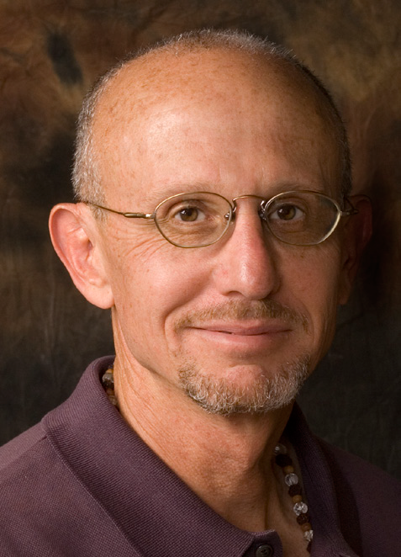
Origins of Primordial Sound Meditation
Chopra Center established in 1996 in San Diego is the global source of balance, healing, transformation, and expansion of awareness
Primordial Sound Meditation (PSM) is an ancient technique revived by Dr. Chopra and Dr. Simon in conjunction with scholars in the US and India
Over 100,000 people have been taught and 1,300 teachers have been trained in PSM
Deepak Chopra, M.D.
David Simon, M.D.

Slide 4
Antidote to Stress
Stress results from perceiving obstacles to the fulfillment of our needs and desires
What stresses are you experiencing?
Body responds aggressively to these perceived obstacles or threats – the “fight/flight” response

Slide 5
Eyes – Pupils dilate
Saliva – Flow decreases
Fight/Flight/Freeze
Lungs – Quick, shallow breathing occurs
Heart – Beats faster and harder
Heart beats faster/pumps blood more quickly
Blood pressure rises
Consume more oxygen and expel more carbon dioxide
Perspiration increases
Adrenal glands pumps out adrenaline, noradrenaline, and cortisol
Pancreas releases more glucagon and less insulin, raising blood sugar
Shunt blood from your digestive organs to your muscles
Release less rejuvenating hormones (DHEA, growth hormone)
Immune system becomes suppressed
Platelets become stickier
Stomach – Output of digestive enzymes decreases
Bowel – Food movement slows down
Blood vessels – Blood pressure increases as major vessels dilate
Skin – Blood vessels constrict; chills and sweating
Muscles – Become more tense; trembling can occur

Slide 6
The Seeds of Illness
Regular activation of flight/fight response in non-life threatening situations can weaken our health.
Change in Physiology | Leads to
Increased blood pressure, heart stress | Coronary heart disease
Increased stress hormones | Anxiety, insomnia, addictions
Increased blood sugar | Diabetes, obesity
Decreased circulation to digestive tract | Digestive disturbances
Decreased growth and sex hormones | Premature aging
Decreased immunity | Infections, cancer
Increased sticky platelets | Heart attacks, strokes

Slide 7
Restful Awareness
During meditation, the body shifts into a state of restful awareness which counterbalances the fight/flight response
Heart rate slows/pumps blood more slowly
Blood pressure normalizes
Consume less oxygen and expel less carbon dioxide
Perspire less
Adrenal glands produce less adrenaline and cortisol
Produce more rejuvenating hormones (DHEA, growth hormone)
Immune function improves
Breathing slows
Platelet function normalizes

Slide 8
War vs. Peace
Fight/Flight/Freeze | Restful Awareness
 Up: Heart rate |  Down: Heart rate
 Up: Blood pressure |  Down: Blood pressure
 Up: Respiration |  Down: Respiration
 Up: Prespiration |  Down: Perspiration
 Up: Stress hormones |  Down: Stress hormones
 Down: Anti-aging hormones |  Up: Anti-Aging hormones
 Up: Platelet stickiness |  Down: Platelet stickiness

Slide 9
Software of the Soul
Action Karma
Desire Vasanas
Memory Sanskara

Slide 10
Meditation and Conscious Choice Making
The choices we make are made based on past actions (karma), which create unique memories (sanskara) and desires (vasanas), which prompt future action.

Slide 11
Basics of Meditation
Primordial Sound Meditation takes you beyond mind, intellect and ego
Between each thought there is a gap
This gap is silent and the field of infinite possibilities
You are not your thoughts – your true self is in the gap

Slide 12
Life is multi-dimensional
According to Adi Shankara, 9th century yogic sage, there are 3 primary layers of life: physical, psychological and spiritual.
Although we tend to think of these levels of existence as separate, they are consciousness in different disguises.
When we are able to freely access these different layers, we achieve balance and integration.
Primordial Sound Meditation traverses the full range of experience, from the manifest to the unmanifest.

Slide 13
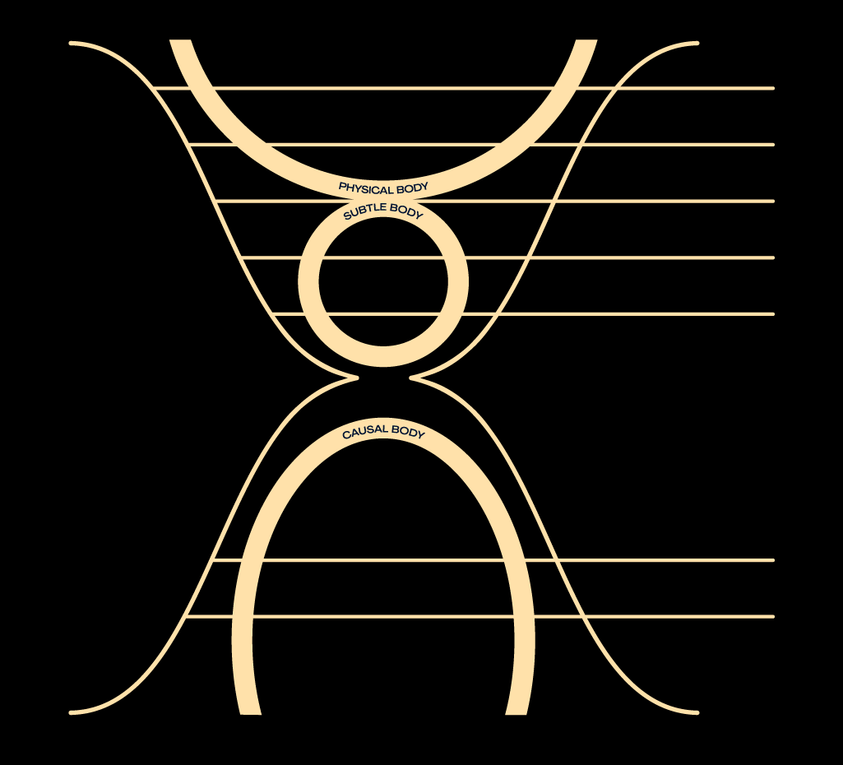
Environment
Extended Body
Body
Layers of Life
Energy
Personal Body
Vital Force
Mind
Emotions, Feelings, Desires
Intellect
Ego
Ideas, Concepts, Notions, Beliefs, Discriminations
Conventional “I”
Personal Soul
Seeds of Memory & Desire
Collective Soul
Myths, Archetypes, Gods & Goddesses
Universal
Pure Potentiality Spirit

Slide 14
Primordial Sounds
Everything in creation is made of vibration
Primordial sounds are the vibration of the universe
Cognized by ancient sages and recorded in relation to the position of the moon
Your primordial sound mantra has the effect of drawing your awareness back to the gap

Slide 15
Next Sessions
Receiving Your Mantra
Perfecting Your Practice of Meditation
An Exploration of Higher States of Consciousness

Slide 16
Namaste (NAH-mah-stay)
A Sanskrit word that is translated literally as “I bow to you.”
It is more commonly translated as “the divine light in me honors the divine light in you.”

