Slide 1
Perfect Health: Ayurvedic Lifestyle
Ayurvedic Daily Routines
Your name, Instructor title
Your name
Instructor Title

Slide 2
Creating a Healthy Daily Routine
Align yourself with nature’s rhythms to facilitate the body’s natural processes of digestion, detoxification, and healing
Maximize health and longevity with periods of activity, including mindful movement, and periods of rest, including a healthy sleep routine

Slide 3
Rhythms of Nature
Nature moves and flows in patterns of rest and activity
Circadian: 24-hour cycle of night and day
Seasonal: 12-month cycle of the earth around the sun
Lunar: Monthly cycle of the moon around the earth
Tidal: Gravitational influence of the moon on water

Slide 4
Circadian Rhythm
Vata: 2am – 6am Fresh, awaking, rising: Meditate
Kapha: 6am – 10am Slowing, early activity: Exercise
Pitta: 10am – 2pm Hotter, largest meal, less activity: Agni
Vata: 2pm – 6pm Creative, productive, energy: Meditate
Kapha: 6pm – 10pm Slowdown, relaxing activities: Bedtime
Pitta: 10pm – 2am Detoxification, deep sleep: Agni
10
Pitta
2
Kapha
Vata
6

Slide 5
Optimal Morning Routine
Awaken without alarm clock: approximately 6am
Drink a glass of warm water
Empty bowels/bladder
Brush teeth/clean tongue
Oil pulling
Cleanse nasal passage with neti and nasya
Perform flexibility exercises/mindful movements
Meditate and practice pranayama
Oil massage/bathe
Eat breakfast with awareness
Perform morning work/activity

Slide 6
Optimal Afternoon Routine
Eat lunch (largest meal of the day): 12pm-1pm
Sit quietly for five minutes after eating
Walk for 5-15 minutes to aid digestion
Perform afternoon work/activity
Meditation and pranayama in late afternoon

Slide 7
Optimal Evening Routine
Eat a light dinner at least two hours before bedtime
Sit quietly for five minutes after eating
Walk for 5-15 minutes to aid digestion
Enjoy light activity in the evening
Minimize intense mental work and electronic stimulation
Aim to be in bed with the lights off by 10:30 pm

Slide 8
Restful Sleep
Aim for a 10:30pm bedtime with all lights and electronics off
Practice calming pranayama and gentle yoga
Soothing self massage and warm bath with lavender
Avoid caffeine late in the day and alcohol in the evening
Drink herbal teas, such as chamomile
Read inspirational/spiritual literature
Journal – download thoughts or events of the day. Write down what you are grateful for
Recapitulation
Read inspirational or spiritual literature
Once in bed, close your eyes, tune into your body and breath and, easily fall asleep

Slide 9
Seasonal Cycles
Seasonal influences may affect your level of balance.
Vata Season
Pitta Season
Kapha Season
Late autumn through winter
Midsummer through early autumn
Late winter, spring, and early summer

Slide 10
Vata Season Routine
Vata balancing techniques to counter the effects of seasonal influences:
Favor warm food and drinks
Favor sweet, sour, salty tastes
Reduce pungent, bitter and astringent tastes
Hydrate
Reduce dry or raw foods
Stay warm
Grounding practice

Slide 11
Pitta Season Routine
Pitta balancing techniques to counter the effects of seasonal influences:
Favor cooling foods and drinks
Favor sweet, bitter and astringent tastes
Reduce sour, salty and pungent tastes
Avoid overheating when exercising
Use cooling aromas

Slide 12
Kapha Season Routine
Kapha balancing techniques to counter the effects of seasonal influences:
Favor a lighter diet
Favor warm foods and drinks
Eat more pungent, bitter, astringent tastes
Enlivening exercises
Cleanse
Dress to stay warm

Slide 13
Times of Change
Simplify your diet during times of transformation
Occasional fasting can be a useful tool
Nourish yourself
Cultivate peace and clarity by releasing negative emotions
Journal

Slide 14
Enhancing Life Force
Gaze into the night sky (Space)
Walk in abundant vegetation, ideally at dusk and dawn (Air)
Allow the light and warmth of the sun to permeate you (Fire)
Walk along natural bodies of water (Water)
Walk barefoot on natural earth (Earth)
Pranayama practices

Slide 15
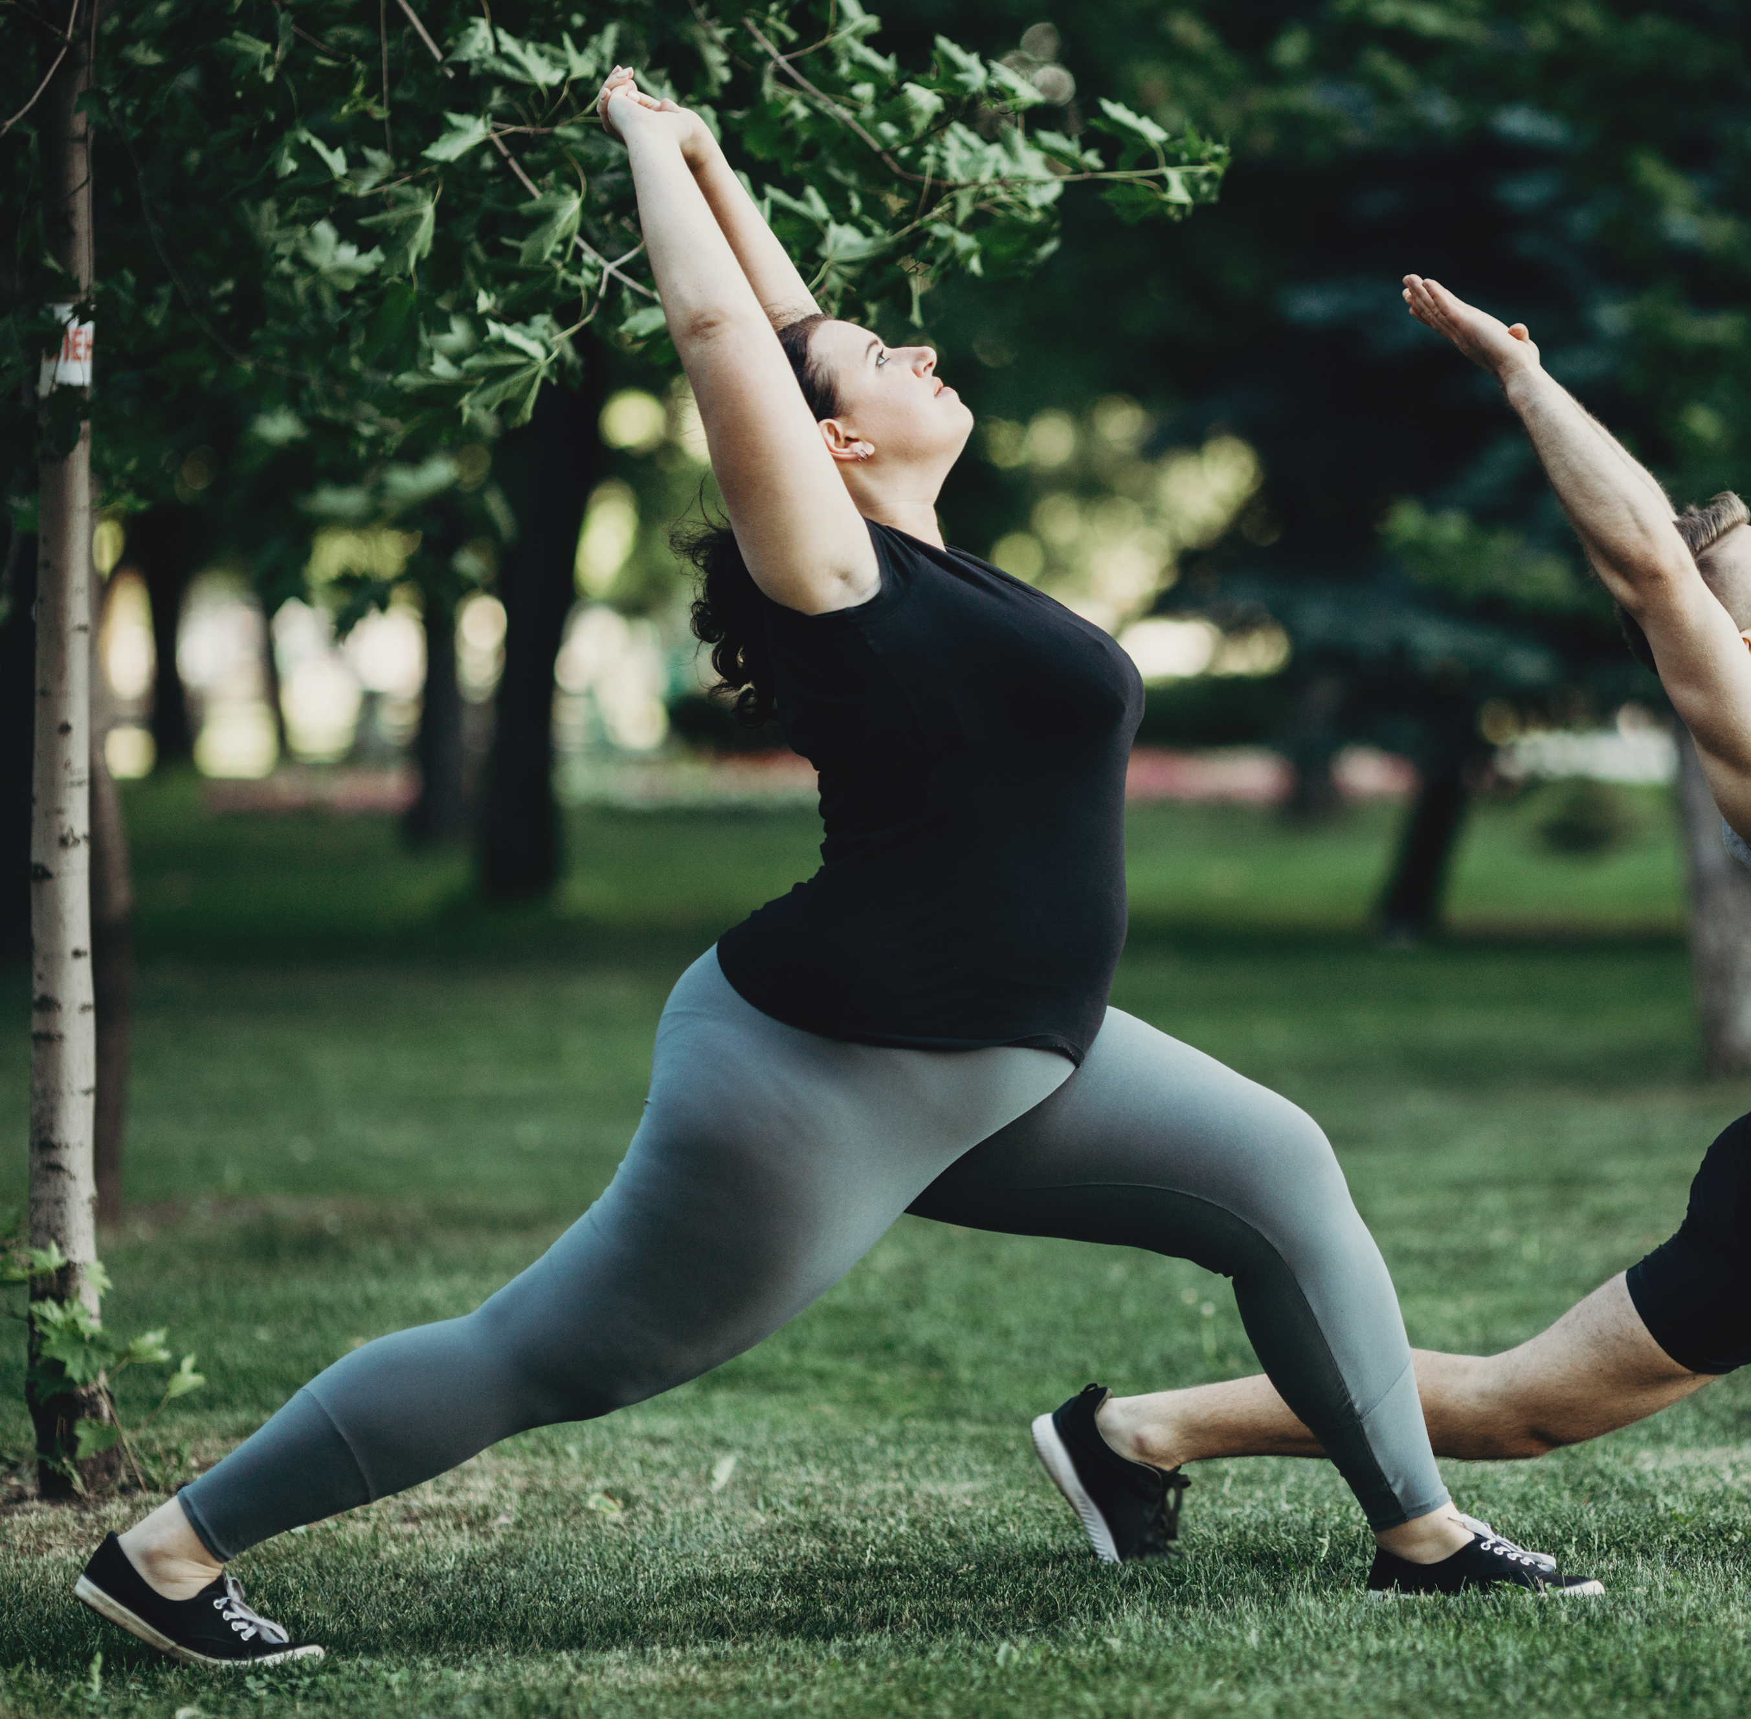
Mindful Movement - Exercise
Essential components of a complete fitness program:
Flexibility
Strength
Cardio

Slide 16
Vata Balancing
Tai chi
Yoga
Walking
Short hikes
Light bicycling

Slide 17
Pitta Balancing
Brisk walking or jogging
Swimming
Biking
Snowboarding or skiing
Outdoor activities
Avoid overheating and avoid being overly competitive

Slide 18
Kapha Balancing
Enjoy vigorous and longer workouts and movements
Running
Cardio
Dance
Rowing
Active yoga
Weight training

Slide 19
Enlivening Health
Integrate the optimal daily routines.
Stay in harmony with the changing seasons.
As you begin to practice Ayurvedic lifestyle, observe how these daily practices will help you cultivate a lifestyle to support your physical, emotional, and spiritual well-being.

