Slide 1
Introduction to Meditation
Your name
Instructor title

Slide 2
What is Meditation?
A journey from activity to silence.
A practice to train our attention and awareness.
An opportunity to de-stress the mind.
The unfoldment of our inner potential.
Reconnection with the essential Self.

Slide 3
Body, Mind, and Soul
The choices we make about our experiences change our bodies, including our choices about:
Food
Personal relationships
Sensory experiences
Sleep
Work
Social interactions
Daily routine

Slide 4
Body, Mind, and Soul
As Deepak teaches, the six most important pillars of health to focus on in our daily lives are:
Sleep
Meditation
Mindful Movement
Healthy Emotions
Grounding/Connection to Nature
Optimal Nutrition

Slide 5
The Benefits of Meditation
Current scientific research validates that having a regular meditation practice produces tangible benefits for mental and physical health, including:
Improved immune function
Reduced worry, anxiety and depression
Increased rejuvenating, anti-aging hormones
Better cognitive skills
More meaningful relationships
Enlightenment
Meditation can even change gene expression to promote healing, self-regulation, and homeostasis (balance).

Slide 6
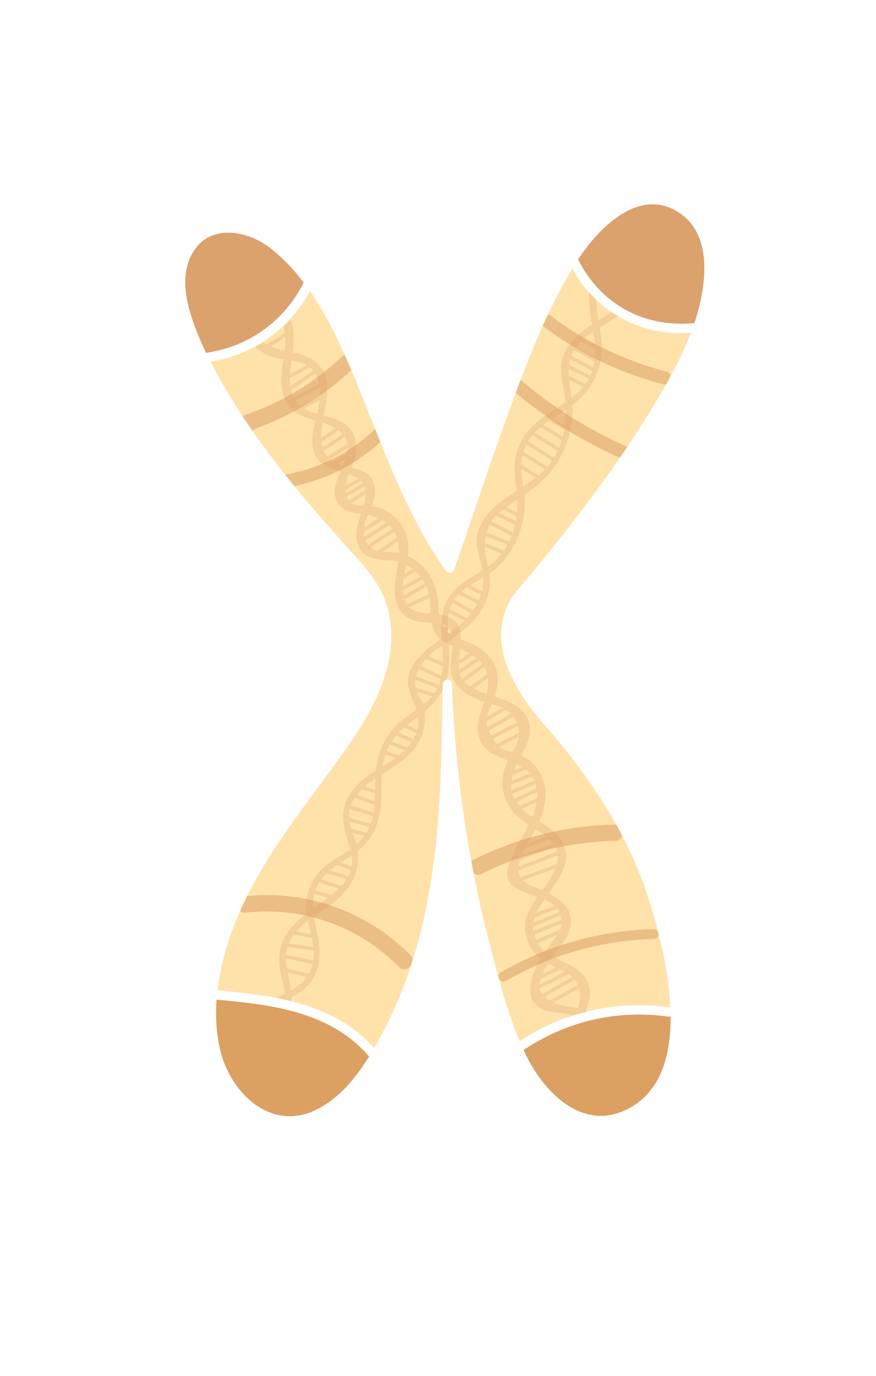
Chromosome:
Telomeres
Chromosomes carry all the information a cell needs to grow, exist, and thrive.
When chromosomes are healthy, our cells are healthy.
Vibrant, healthy cells are the foundation of a healthy body.
Telomeres are the end caps of chromosomes and protect them from fraying, like the end caps of shoelaces.
Meditation is proving to protect and lengthen telomeres, thus increasing the protection of each chromosome.
Telomeres

Slide 7
Meditation and Gene Expression
The mind and emotions affect gene activity and expression.
We can take control of our mind and emotions through meditation.
Meditation can help alter gene expression so that certain gene-related diseases may not manifest.
Through meditation and other lifestyle practices, we can influence 95% of our gene expression, thus taking control of our lives and overall health.

Slide 8
Education & Research
Telomerase & Genomics Research Study P02.144LB A Randomized Trial Comparing a Brief Meditation Retreat to a Vacation: Effects on Daily Well-Being. https://www.liebertpub.com/doi/pdfplus/10.1089/acm.2014.5242.abstract
Articles: ​
Telomeres: Aging Secrets to Help You Stay Healthy by Thea Singer. https://www.huffpost.com/entry/telomeres-aging-antiage-telomerase_n_1955963
Weekly Health Tip: The Power of Meditation. https://www.huffpost.com/entry/meditation-telomeres_b_861254
Psychosocial Effects of a Holistic Approach to Well-being in Health and Wellness Courses. https://www.choprafoundation.org/wp-content/uploads/2019/06/2019-06-Patel-et-al-Holistic-Approach-to-Well-being.pdf
How Meditation Can Help Anxiety. https://chopra.com/articles/how-meditation-can-help-anxiety
Meditation Research:​
Cardiovascular and nervous system changes during meditation. https://www.frontiersin.org/articles/10.3389/fnhum.2015.00145/full ​
Systems biology research study reveals benefits of vacation and meditation. https://www.eurekalert.org/pub_releases/2016-08/tmsh-sbr082916.php

Slide 9
What is stress?
Stress results from perceiving obstacles to the fulfillment of our needs and desires.
Through the “fight/flight/freeze” response, our bodies respond to these perceived obstacles or threats.
What stresses are you experiencing right now?
How do they make you feel?

Slide 10
Eyes – Pupils dilate
Saliva – Flow decreases
Fight/Flight/Freeze
Lungs – Quick, shallow breathing occurs
In response to stress:
The heart beats faster/pumps blood more quickly
The blood pressure rises
We consume more oxygen and expel more carbon dioxide
Perspiration increases
The adrenal glands pump out adrenaline, noradrenaline, and cortisol
The immune system becomes suppressed
Blood platelets become stickier
Heart – Beats faster and harder
Blood vessels – Blood pressure increases as major vessels dilate
Stomach – Output of digestive enzymes decreases
Bowel – Food movement slows down
Skin – Blood vessels constrict; chills and sweating
Muscles – Become more tense; trembling can occur

Slide 11
The Fight Response
Humans naturally defend against threats and when we respond to a threat by fighting, we exhibit:
Irritability
Loss of temper
Defensiveness
This response corresponds to the Pitta dosha.
Fight
Flight
Freeze

Slide 12
The Flight Response
When we respond to a threat by fleeing, we tend to:
Avoid the threat
Become anxious
Become fearful
This response corresponds to the Vata dosha.
Fight
Flight
Freeze

Slide 13
The Freeze Response
Sometimes, when perceiving a threat, we defend ourselves by freezing.
Numbing
Detachment
Giving up easily
This response corresponds to the Kapha dosha.
Fight
Flight
Freeze

Slide 14
The Seeds of Illness
Change in Physiology | Contributes to
Increased blood pressure, heart stress | Coronary heart disease
Increased stress hormones | Anxiety, insomnia, addictions
Increased blood sugar | Diabetes, obesity
Decreased circulation to digestive tract | Digestive disturbances
Decreased growth and sex hormones | Premature aging
Decreased immunity | Infections, cancer
Increased sticky platelets | Heart attacks, strokes

Slide 15
Restful Awareness
During meditation, the body shifts into a state of restful awareness which counterbalances the fight/flight/freeze response.
The heart rate slows/pumps blood more slowly
Blood pressure normalizes
Perspiration decreases
Adrenal glands produce less adrenaline and cortisol
Immune function improves
Breathing slows down
Platelet function normalizes

Slide 16
Restful Awareness
Fight/Flight/Freeze | Restful Awareness
 Up: Heart rate |  Down: Heart rate
 Up: Blood pressure |  Down: Blood pressure
 Up: Respiration |  Down: Respiration
 Up: Perspiration |  Down: Perspiration
 Up: Stress hormones |  Down: Stress hormones
 Down: Anti-aging hormones |  Up: Anti-Aging hormones
 Up: Platelet stickiness |  Down: Platelet stickiness

Slide 17
How to Prepare for Meditation
Meditation can be practiced anywhere.
Meditation is best practiced in a comfortable seated position with your eyes closed.
Use pillows and blankets if needed.
Avoid lying down unless you are unable to sit upright comfortably.
Minimize potential distractions such as phones, music, and television.

Slide 18
What is a Mantra?
A mantra is a thought with no particular meaning.
Most thoughts have a sound and a meaning.
Meaning holds the mind at the active thinking level.
When thinking a mantra, there is nothing to hold the mind at the active thinking level.
So Hum is a mantra meditation using the vibration of the breath.

Slide 19
How to Meditate
Sitting comfortably with your eyes closed, gently introduce the silent repetition of the mantra, So Hum.
On the inhale, mentally repeat the word, So. On the exhale, mentally repeat the word, Hum.
When you become aware you have drifted away to other thoughts, sounds, or sensations, gently return your attention to your breath and the repetition of So Hum.
End your meditation by letting go of the mantra.
Remain with your eyes closed for a few minutes, then gently move back into activity.
Use a watch or meditation app to time your meditations and always allow for proper time to come out of meditation – even if it means ending meditation early.

Slide 20
Experiences
You can have several different experiences during meditation:
Repeating the Mantra
Thinking thoughts and restlessness
Falling asleep
Slipping into the “Gap”

Slide 21
Expectations
Avoid seeking a particular experience or result during meditation.
Approach meditation with innocence and non-judgment.
Each meditation is unique and will be best suited for you at that moment.
Practice effortlessness and allow the natural process to unfold.

Slide 22
Enlivening Health
The six pillars of health allow you to access your deepest potential for health.
One of the foundational practices of an Ayurvedic lifestyle is meditation.
The key to meditation is to be effortless.
Meditation enriches all aspects of your life.

Slide 23
“Meditation is not a way of making your mind quiet.
It is a way of entering into the quiet that is already there.”
Deepak Chopra

